Slide 1
A project on “ online food ordering system ”

Slide 2
ACKNOWLEDGEMENT
We would like to express our profound thanks to all those who helped in making this project a reality. Much needed moral support and encouragement was provided on numerous occasions by all teachers and fellow students.
We are thankful to our Head of the Department. We are also especially grateful to our teacher and project guide Mrs. Rajeshri Gaikwad for his time to time, much needed, valuable guidance. she has been available to help us whenever required. she has been our guiding star, guiding us through the right direction to make this project a success. Without his full support and cheerful encouragement we would have not been able to complete the project in time. We are sincerely thankful to him. Last but not the least we would like to thank our fellow student for providing their support to us in different ways.

Slide 3
INTRODUCTION
In a modern generation Online food ordering is a mobility of food delivery or takeout from a local restaurant or food cooperative. Now days the rapid growth in the use of internet and the technologies associated with it, the several opportunities are coming up on the web or mobile application. This is made possible through the use of electronic payment system. The payment can be done through the customer’s credit card, debit card. It is possible for everyone to order any goods from anywhere the internet and have the goods delivered at his/her home. All types made be internet le transaction ads to the economic of digital cash, the necessary tool for this process telecommunication with customers.
The system will become an important tools use for restaurant to improve the management aspect by use of computer system to connected each and every food ordering transaction instead of data record on it. In addition, it can also provide efficiency for the restaurant by reducing time consuming, minimize human errors or delivery and providing good quality and service to customers. In terms of the integrity and availability of the system provided, it can be concluded that this system is a suitable solution.

Slide 4
OBJECTIVE
The main objective of the Project on Online Food Ordering System is to manage the details of Food, Item Category, Shopping Cart, Customer, Order. It manages all the information about Food, Delivery Address, Order, Food. The project is totally built at administrative end and thus only the administrator is guaranteed the access. The purpose of the project is to build an application program to reduce the manual work for managing the Food, Item Category, Delivery Address, Shopping Cart. It tracks all the details about the Shopping Cart, Customer, Order.
The study has the following specific objectives :-
To develop a system that will surely satisfied the customer service.
To design a system able to accommodate huge amount of orders at a time.
To evaluate its performance and acceptability in terms of security, user-friendliness, accuracy and reliability
To improve the communication between the client and the server and minimize the time of ordering.

Slide 5
THE EXISTING SYSTEM :-

Slide 6
DESCRIPTION OF EXISTING SYSTEM :-
Many of customer’s placed the order for their foods for their ongoing events.
It is very difficult to maintain the record each and every customer’s, customers transactions manually by paper.
The new System Overcome this problem, by computerizing transactions and providing easy backup of the data time to time.

Slide 7
DRAWBACKS OF THE EXISTING SYSTEM :-
Data security .
Risk of losing customer’s data .
Chances of a technical problem in the system .
Mismatch data of orders, customers and drivers .
Difficulty in choosing the right developer to develop a customized system .
More man power .
Time consuming .
Consumes large volume of pare work .
Needs manual calculations .

Slide 8
THE PROPOSED SYSTEM :-

Slide 9
SCOPE OF THE PROPOSED SYSTEM :-
The proposed system is designed to overcome the limitations of existing system. By computerizing the system, human errors will be rectified to the maximum thereby enhancing the efficiency of the system. The obsolete system of manual entry and calculation can be removed and this method could be adopted to bring into action a more efficient system. It may help collecting perfect management in details. In a very short time, the collection will be obvious, simple and sensible. It will help a person to know the management of passed year perfectly and vividly. It also helps in current all works relative to Online Food Ordering System. It will be also reduced the cost of collecting the management & collection procedure will go on smoothly .
Our project aims at Business process automation, i.e. we have tried to computerize various processes of Online Food Ordering System.
In computer system the person has to fill the various forms & number of copies of the forms can be easily generated at a time.
In computer system, it is not necessary to create the manifest but we can directly print it, which saves our time.
To utilize resources in an efficient manner by increasing their productivity through automation.
The system generates types of information that can be used for various purposes.
It satisfy the user requirement
Be easy to understand by the user and operator
Be easy to operate
Have a good user interface
Be expandable
Delivered on schedule within the budget .

Slide 10
BENEFITS OF THE PROPOSED SYSTEM :-
The aim of proposed system is to develop a system of improved facilities. The proposed system can overcome all the limitations of the existing system.
Fully automated and hence reduces human errors and investments.
Customer’s queue is minimized because of the automated system.
Security to the data is given by providing password at various stages.
Flexibility in technology and Implementation.
Easier to maintain, Edit and Update records.
The system provides proper security and reduces the manual work.
Security of data.
Ensure data accuracy’s.
Proper control of the higher officials.
Minimize manual data entry.
Minimum time needed for the various processing.
Greater efficiency.
Better service.
User friendliness and interactive.
Minimum time required.

Slide 11
HARDWARE AND SOFTWARE
REQUIREMENT

Slide 12
Hardware requirements :-
Description | Required
Processor | Pentium III 630MHz
Ram | 128 MB
Hard Disk | 20 GB
Moniter | 15 inches Colour Moniter
Keyboard | 122 Keys
Operating System | 64 Bit

Slide 13
Software requirements :-
Server | Apache 2.4.5
Front-end | Html , Css , Bootstrap , Ajax, Jquery
Back-end | PHP 8.4.1, PostgreSQL 5.5.32 ( using phpmyadmin 5.1.3 )
Integrated Development Environment (IDE) | Netbeans 7.3.1
Platform | Windows 10

Slide 14
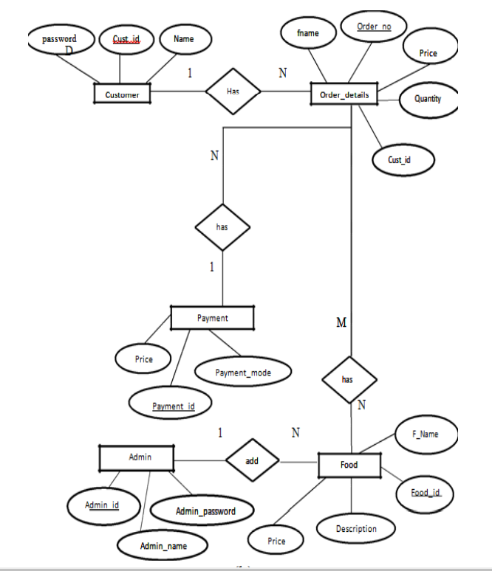
Erd-online food ordering system

Slide 15
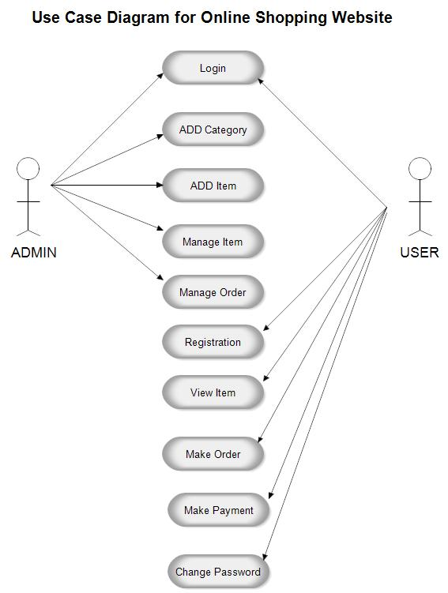
Usecase diagrams :-

Slide 16
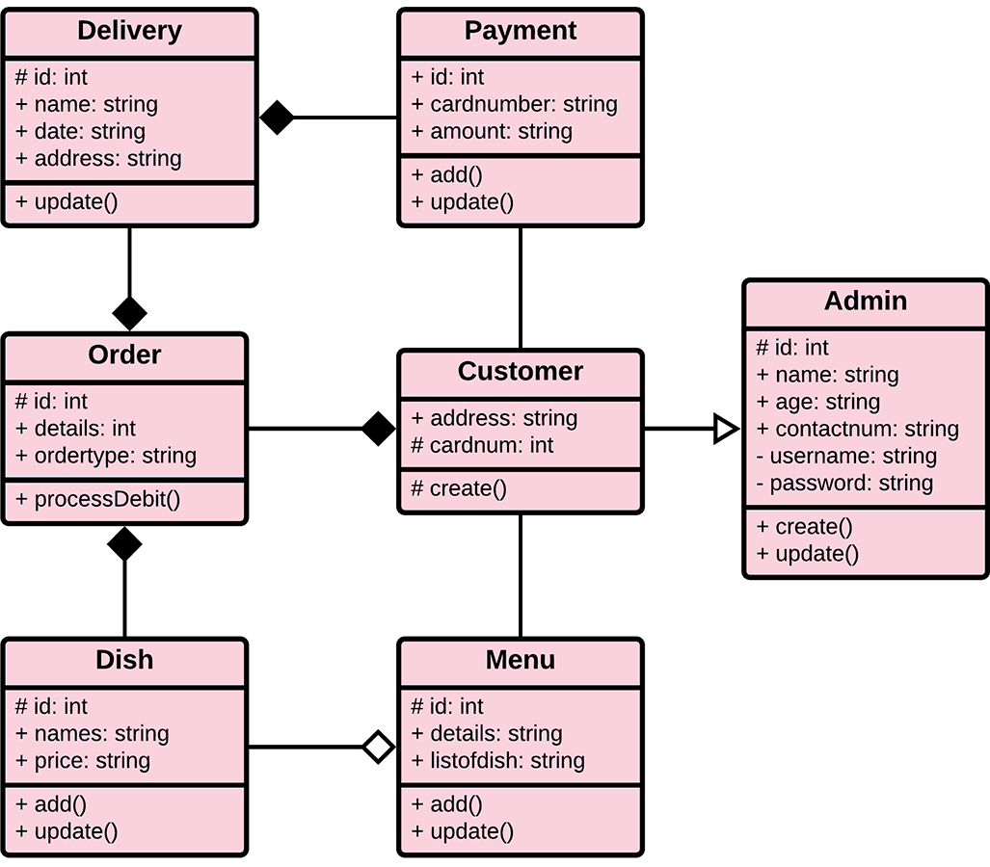
Class diagram :-

Slide 17
Sequance diagram :-

Slide 18
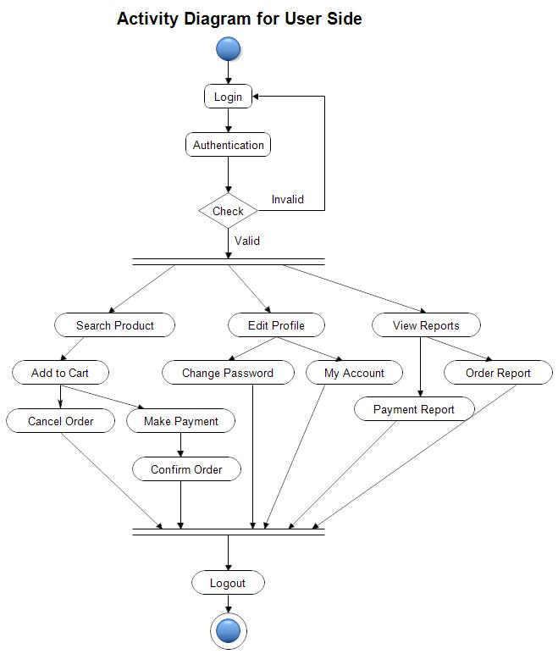
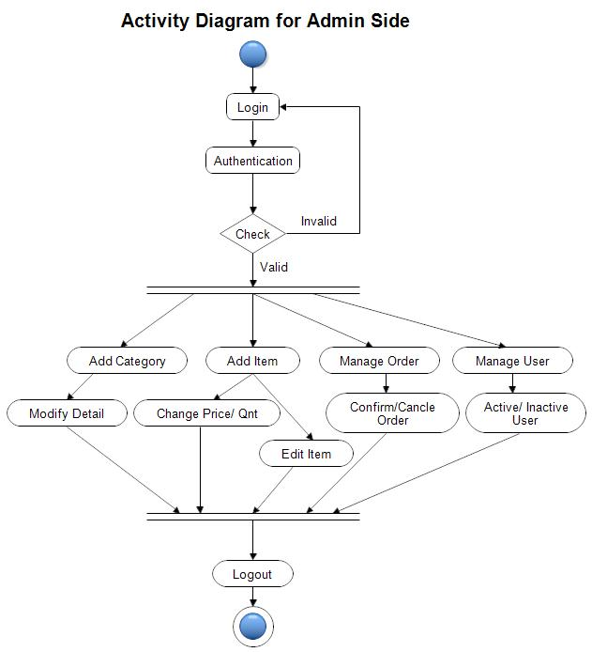
Activity diagram :-

Slide 19
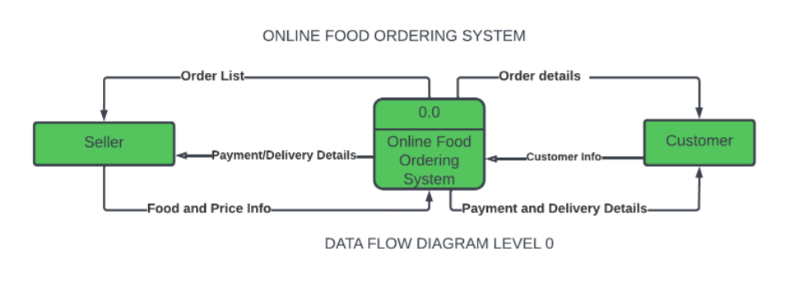
Context Level DFD :-

Slide 20
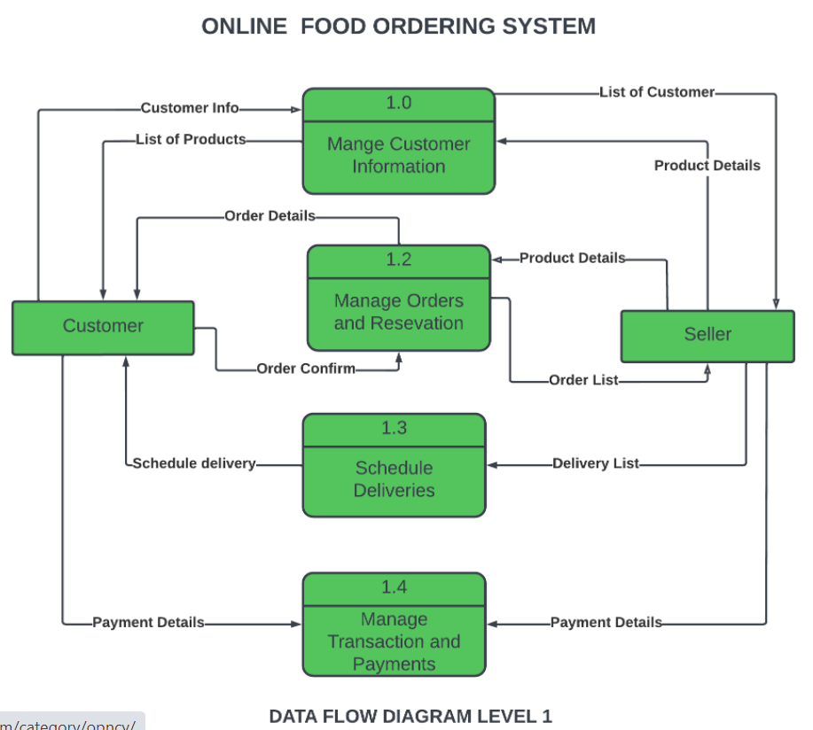
First Level DFD (1st) :-

Slide 21
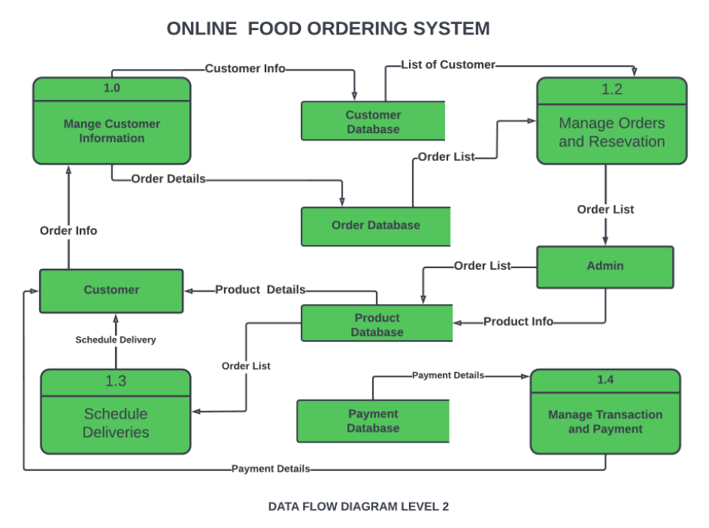
Second Level dfd (2ND) :-

Slide 22
Screen Shorts of website :-

Slide 23
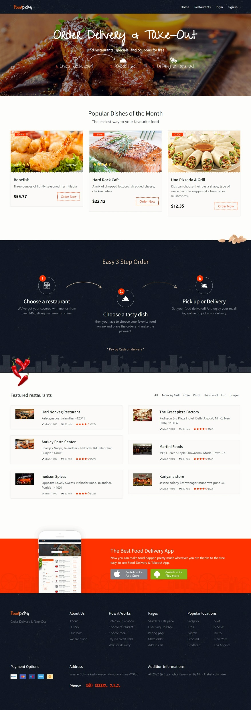
Website interface :-

Slide 24
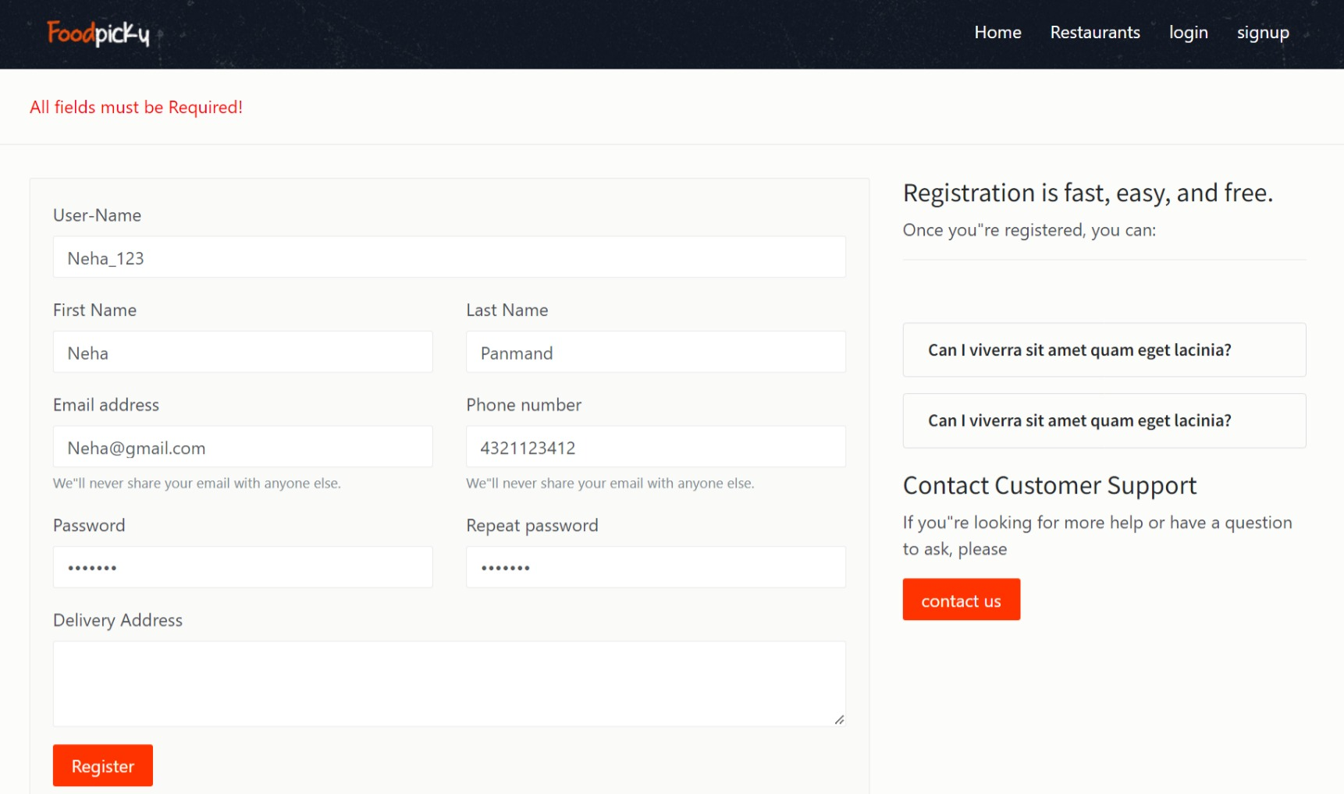
Singup Screen at startup of website :-

Slide 25
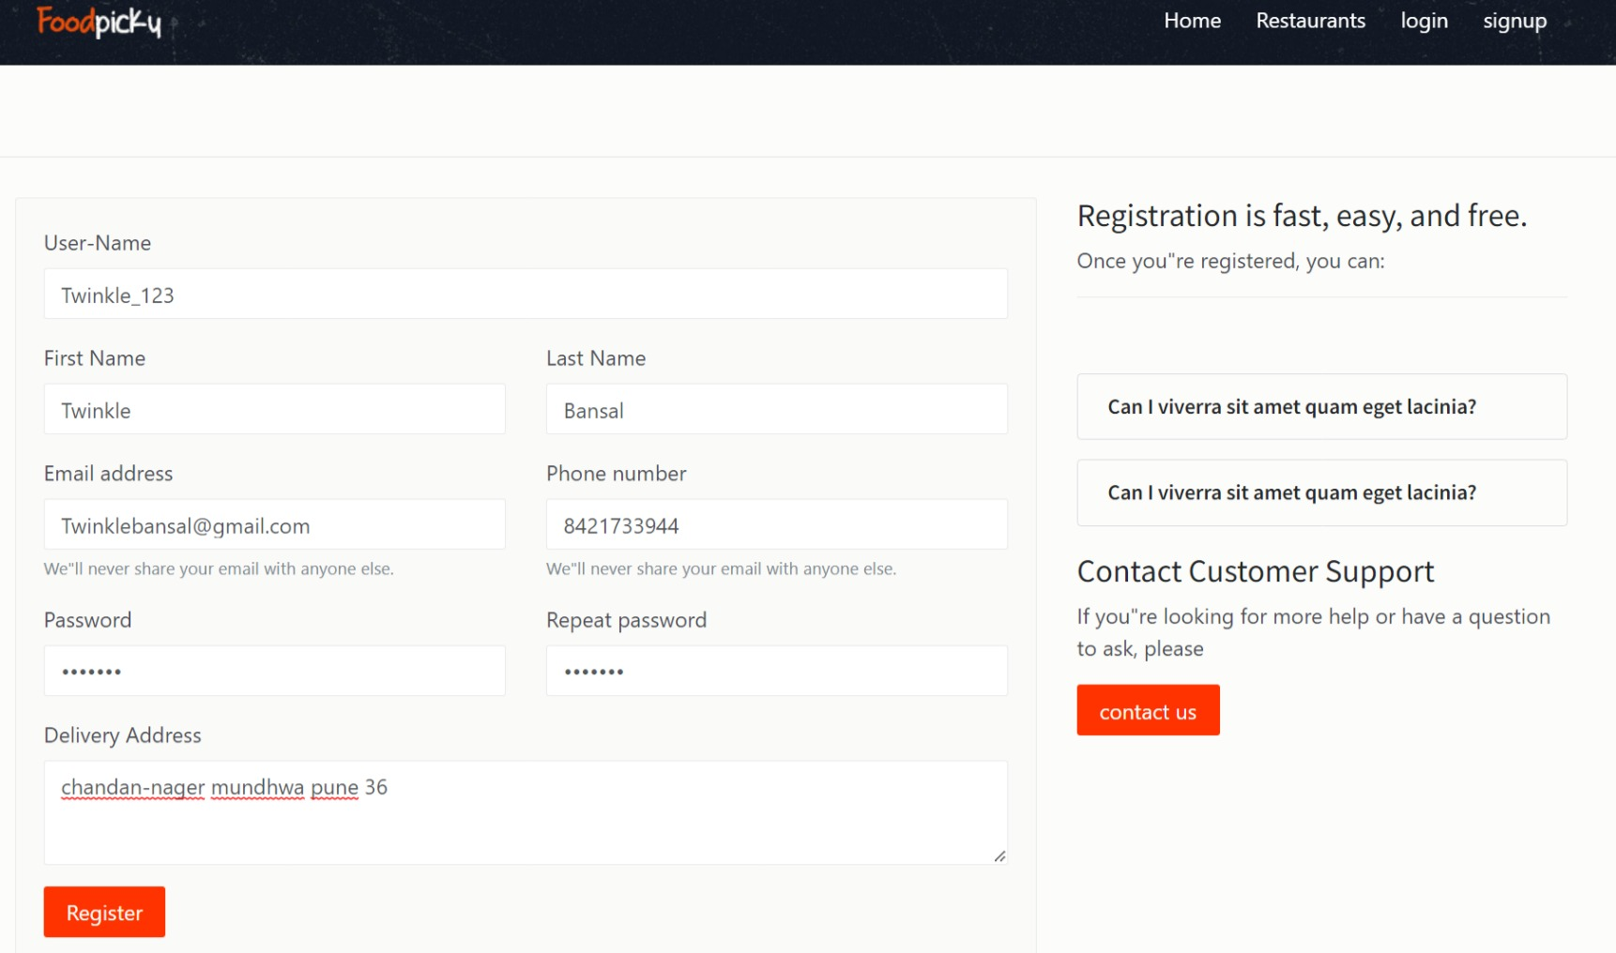
After all fields are filled :-

Slide 26
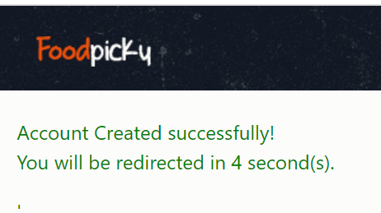
After successful signup / registration :-

Slide 27
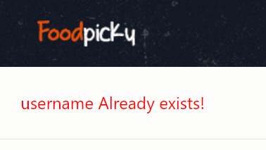
Same username is filled by another person :-

Slide 28
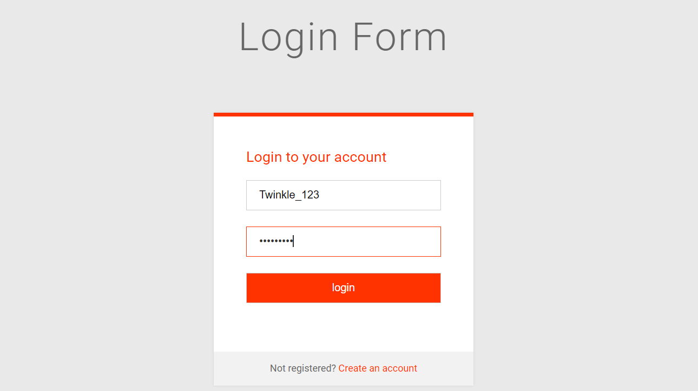
Login Screen at start up of website :-

Slide 29
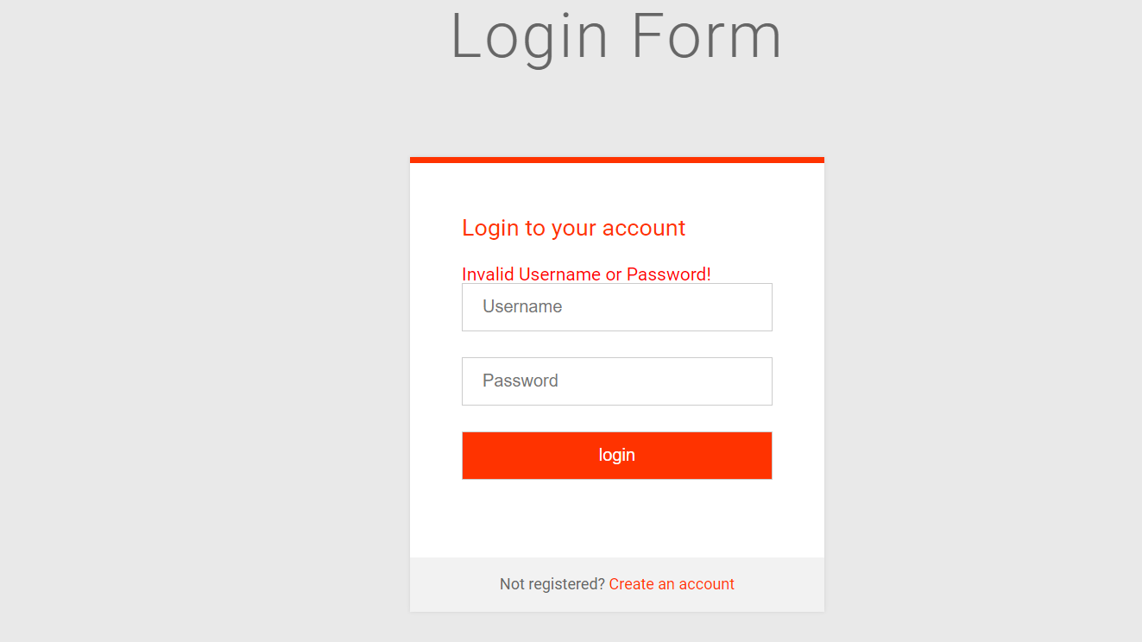
If wrong username or password is inserted:-

Slide 30
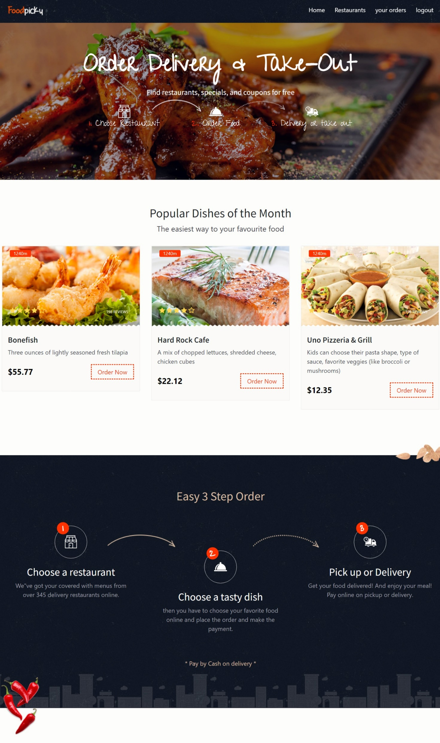
After successful login :-

Slide 31
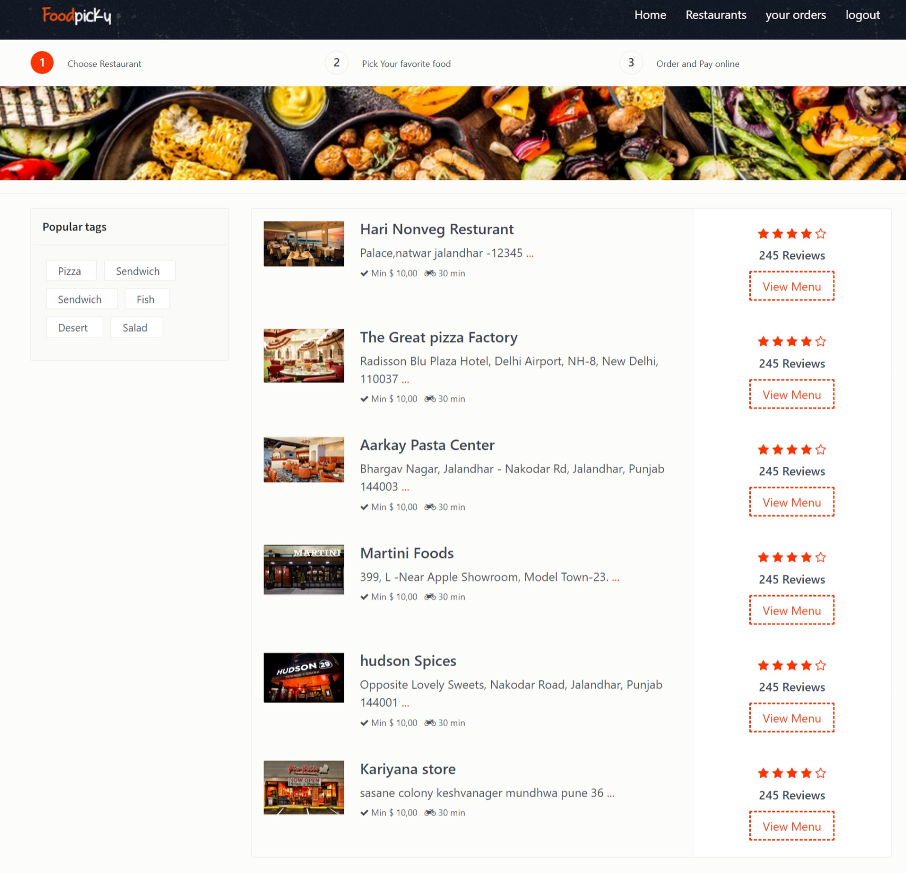
Choose your favoriate resturants :-

Slide 32
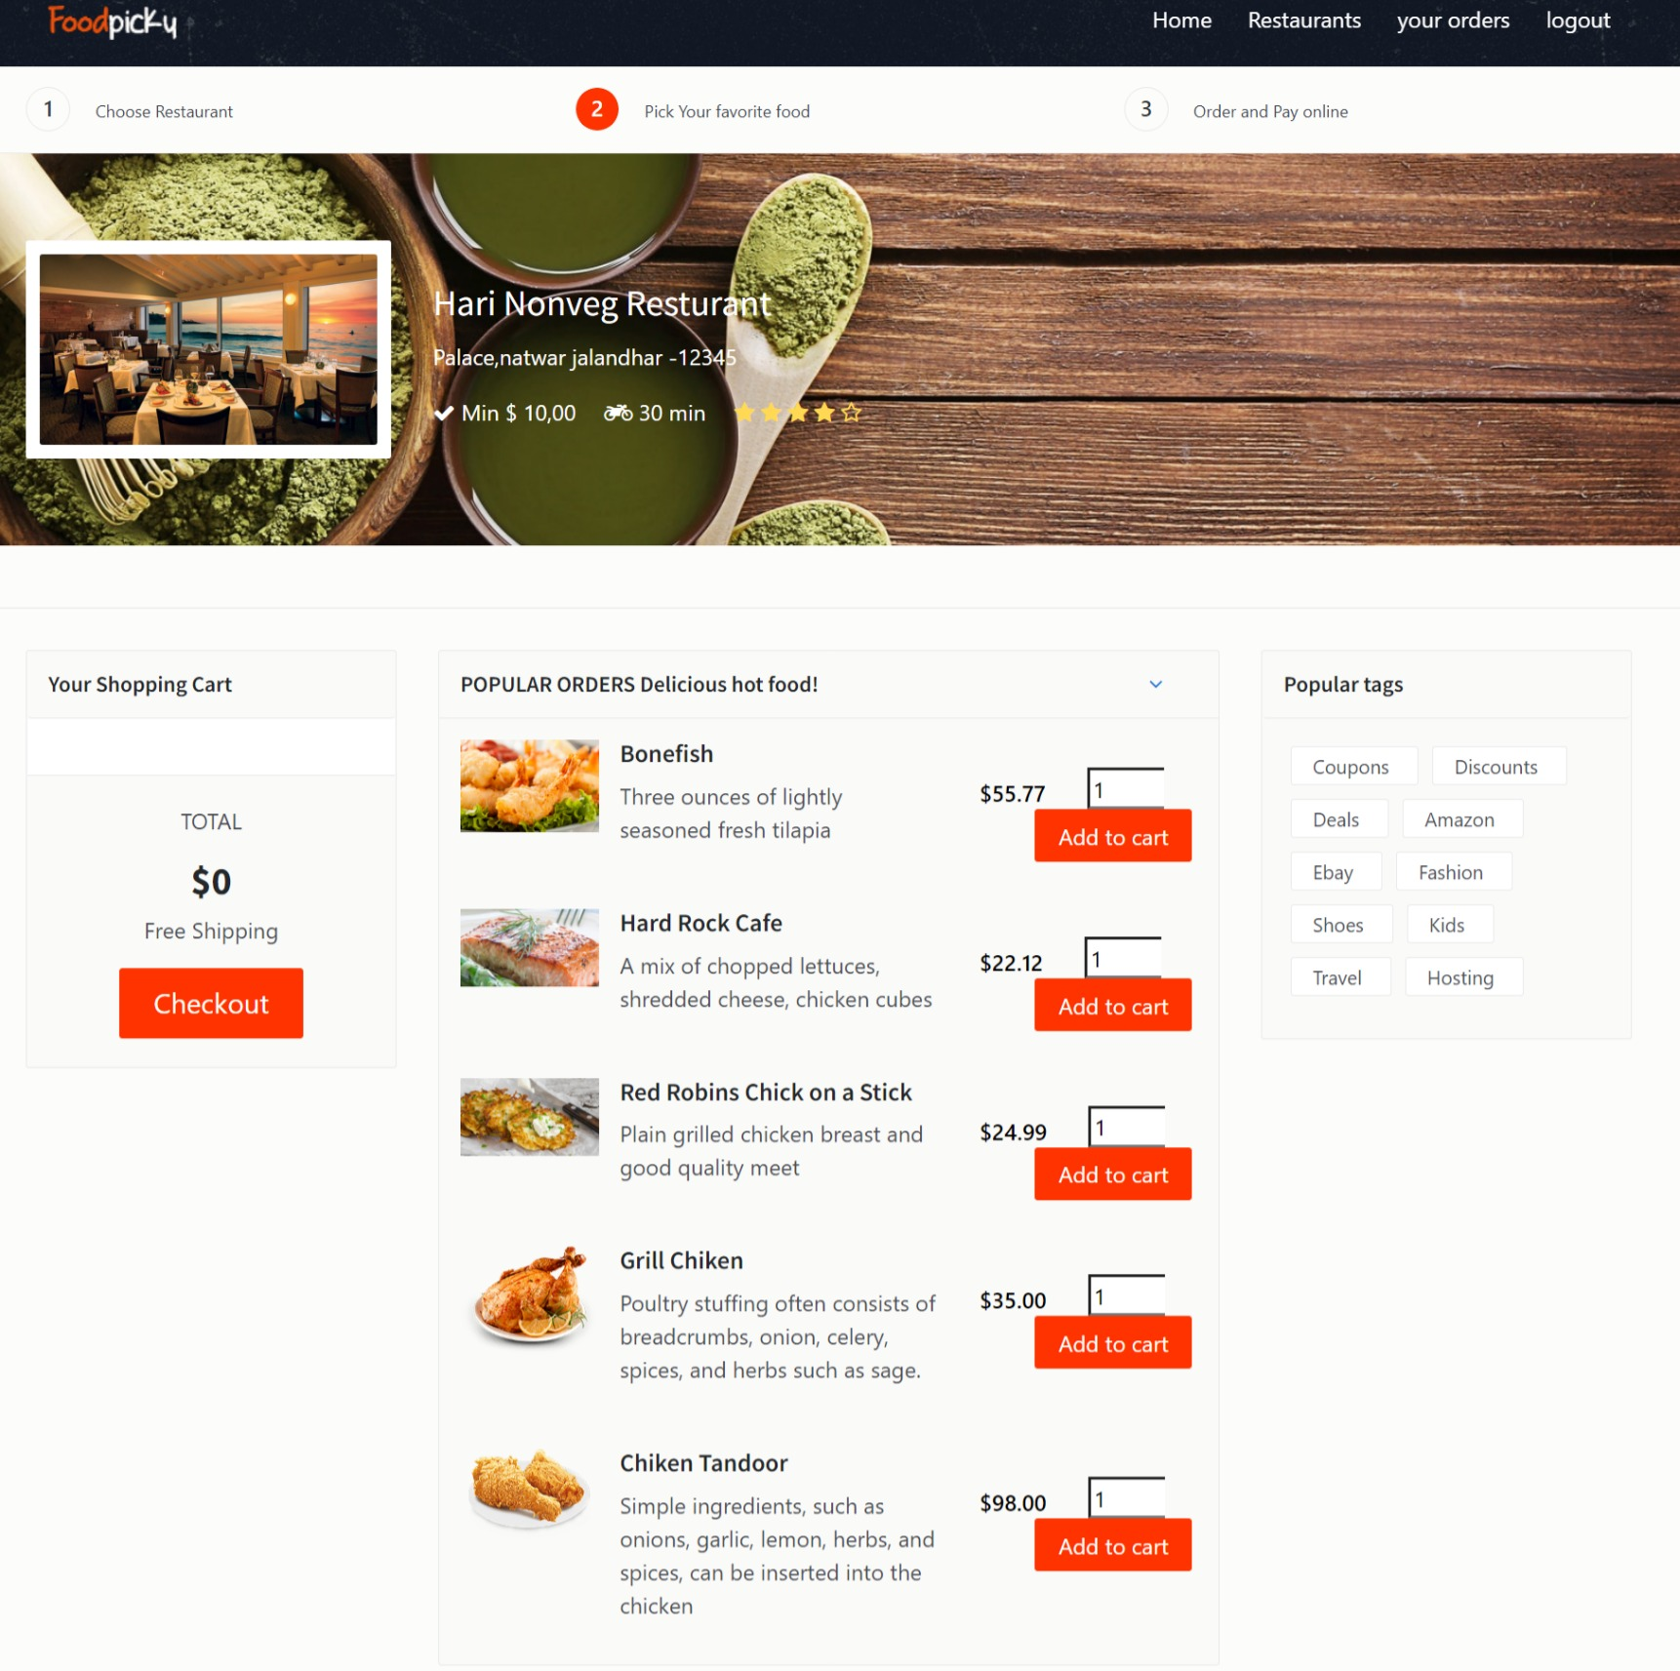
Pick your favoriate food in the restaurant :-

Slide 33
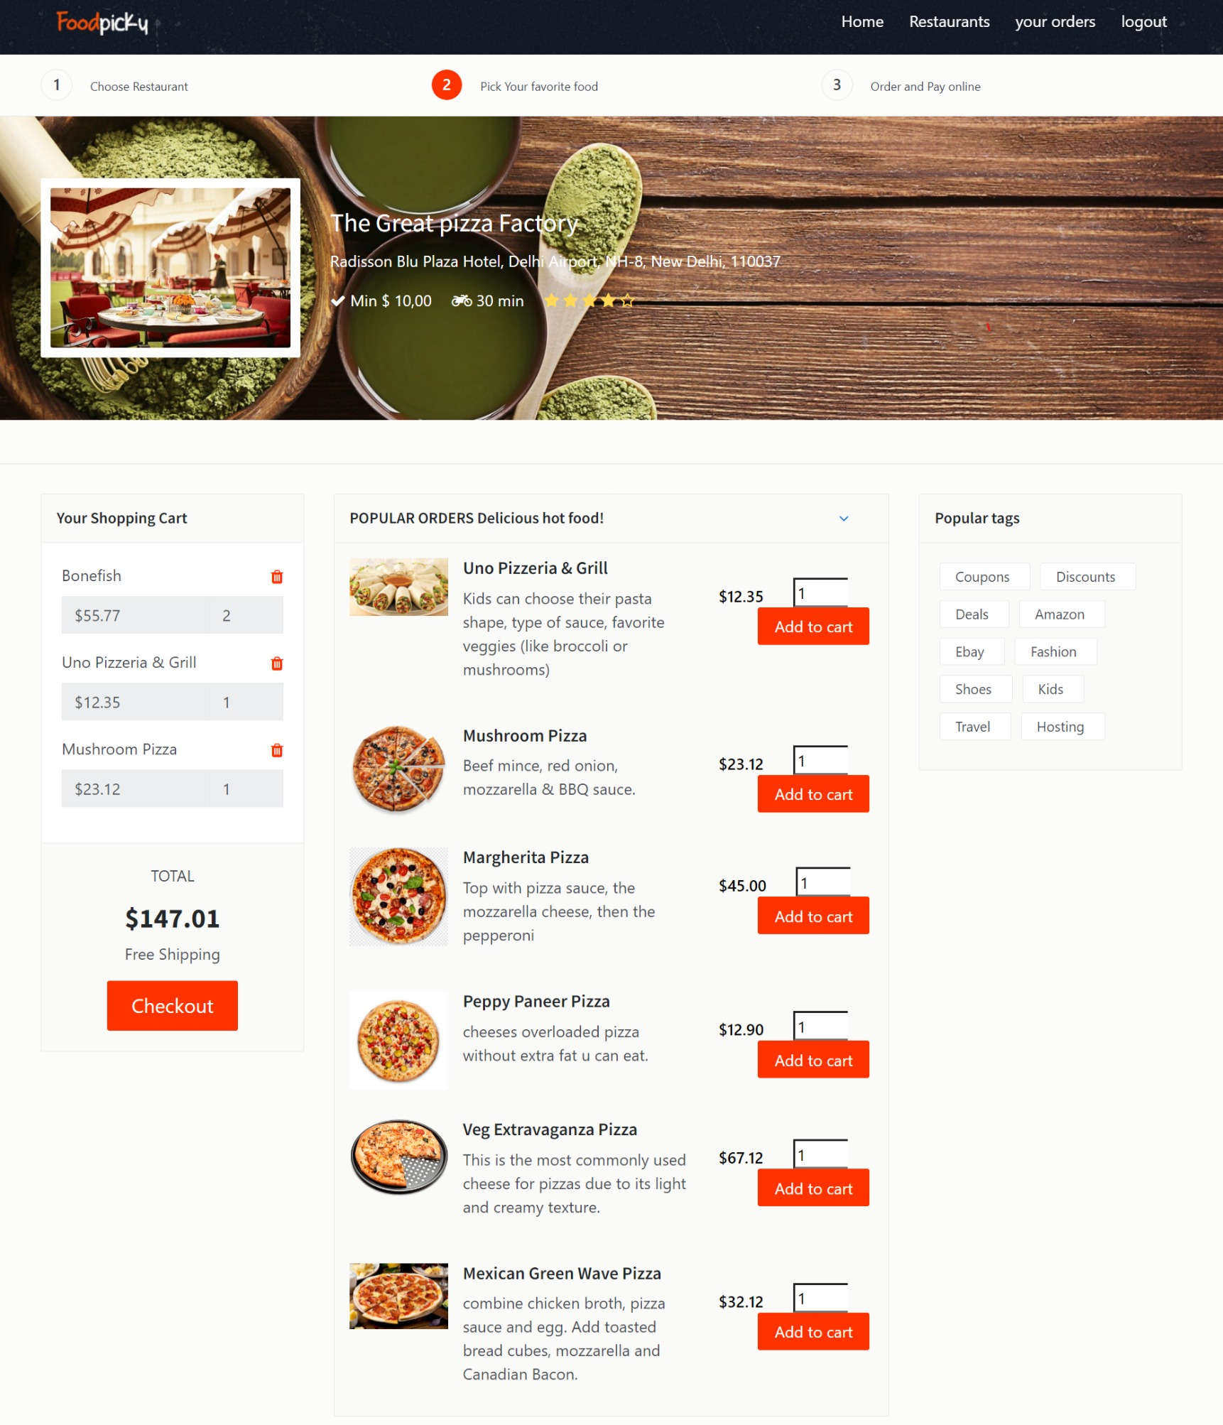
add to the cart and checkout :-

Slide 34
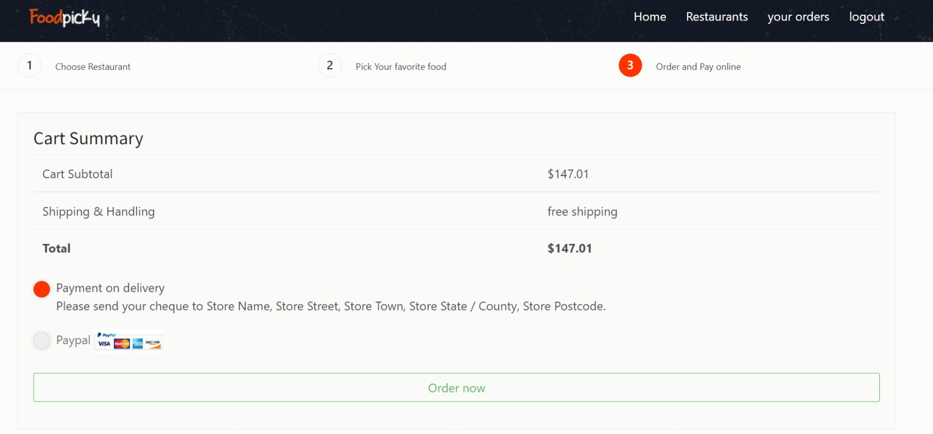
order and pay the bill :-

Slide 35
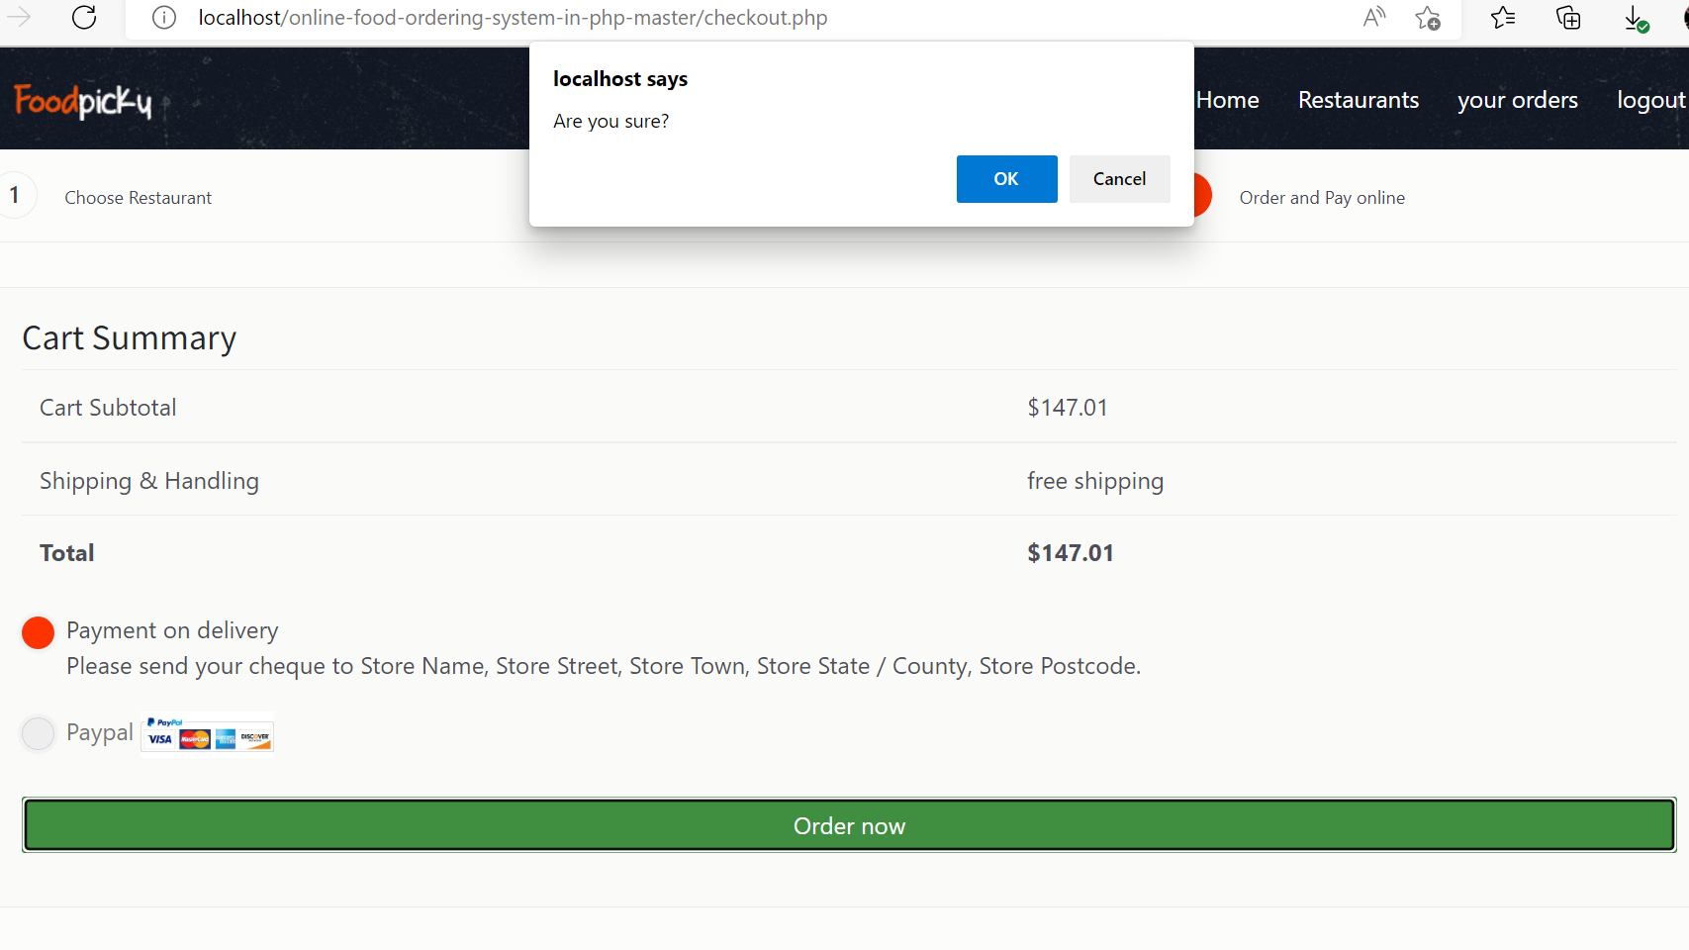
Confirm your food order :-

Slide 36
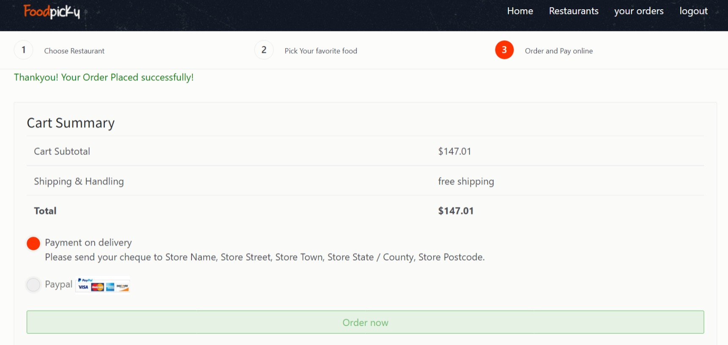
successful transaction the order is placed :-

Slide 37
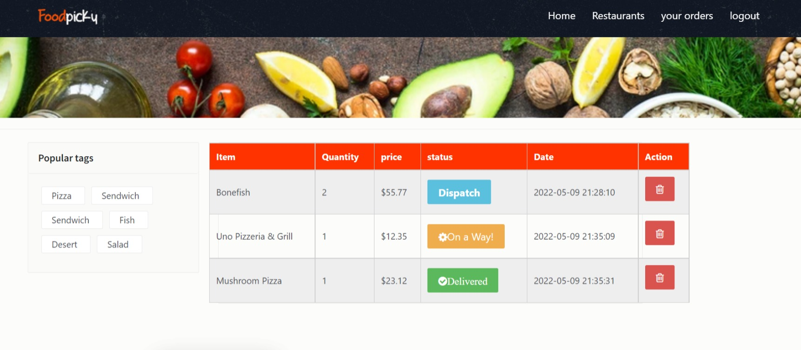
Track your food order :-

Slide 38
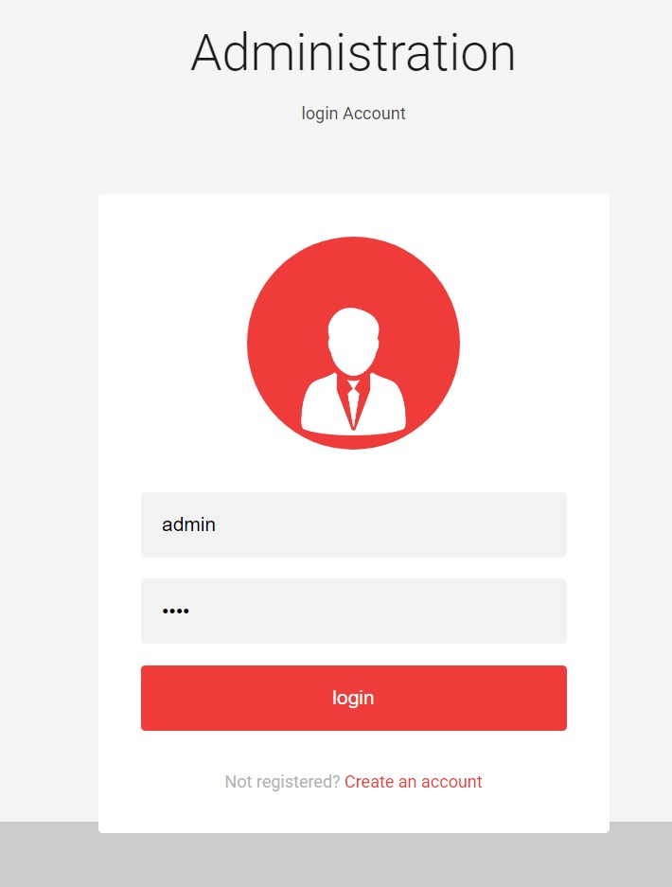
Administration login :-

Slide 39
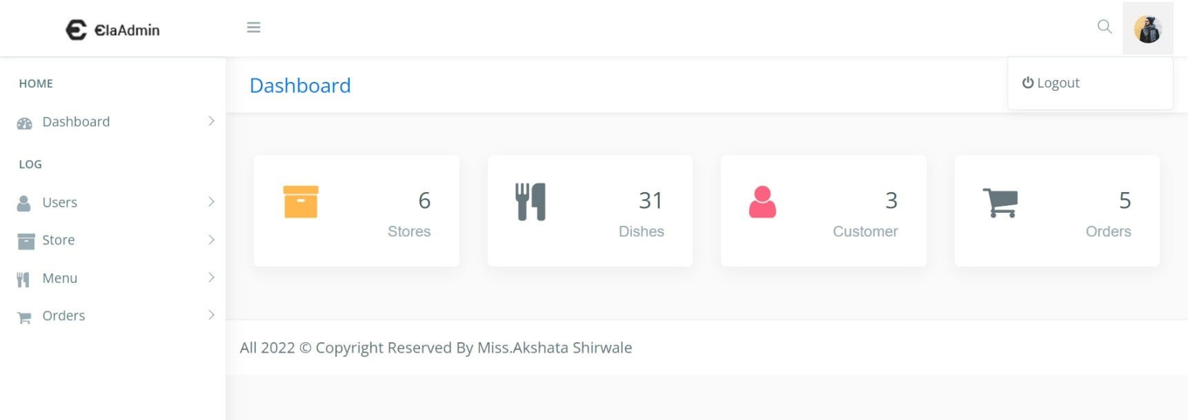
After successful admin login :-

Slide 40
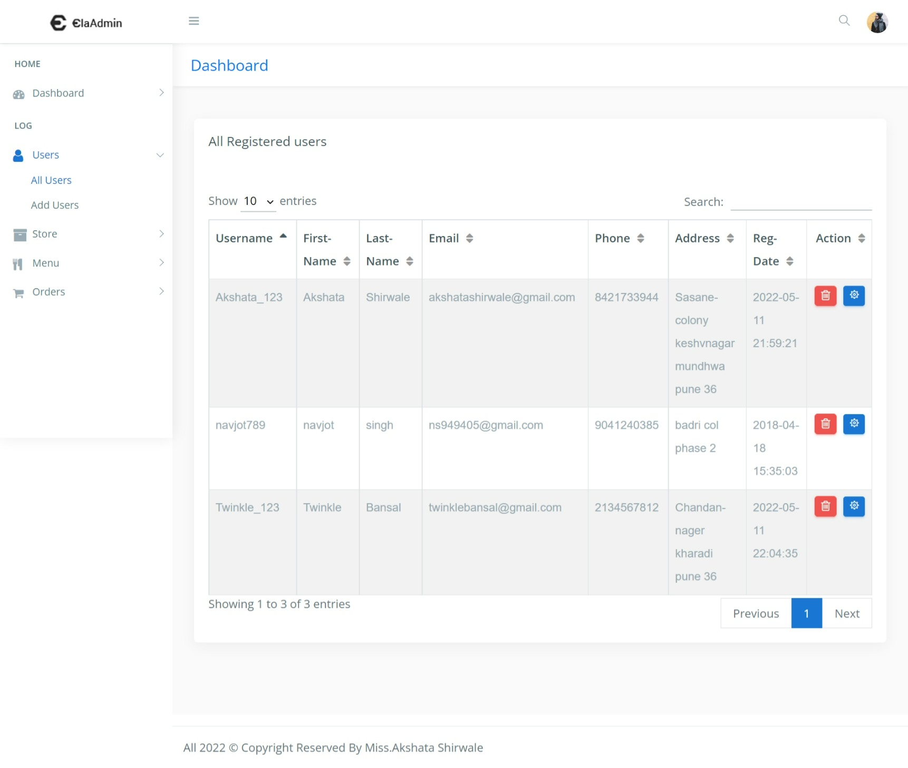
All User dashboard :-

Slide 41
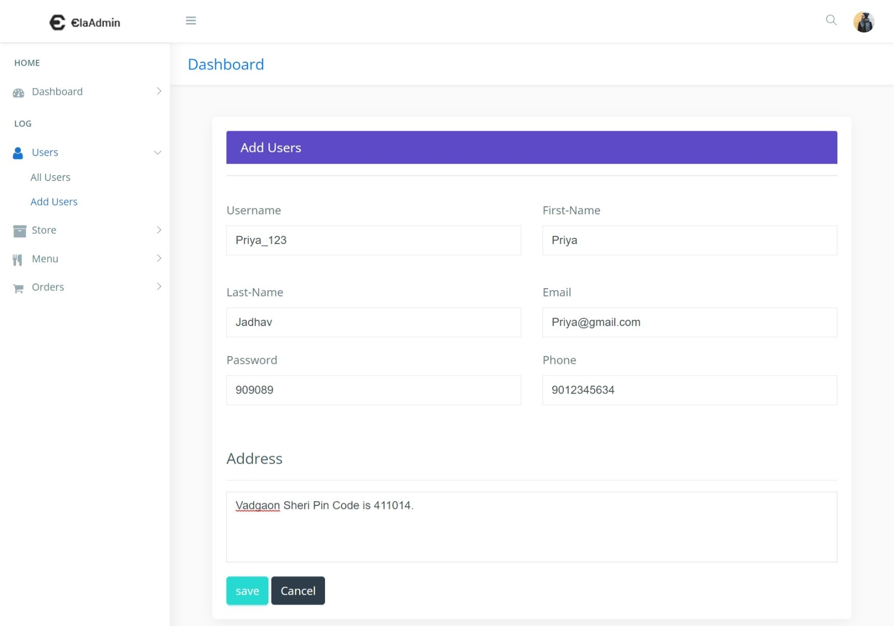
Form to add the new user :-

Slide 42
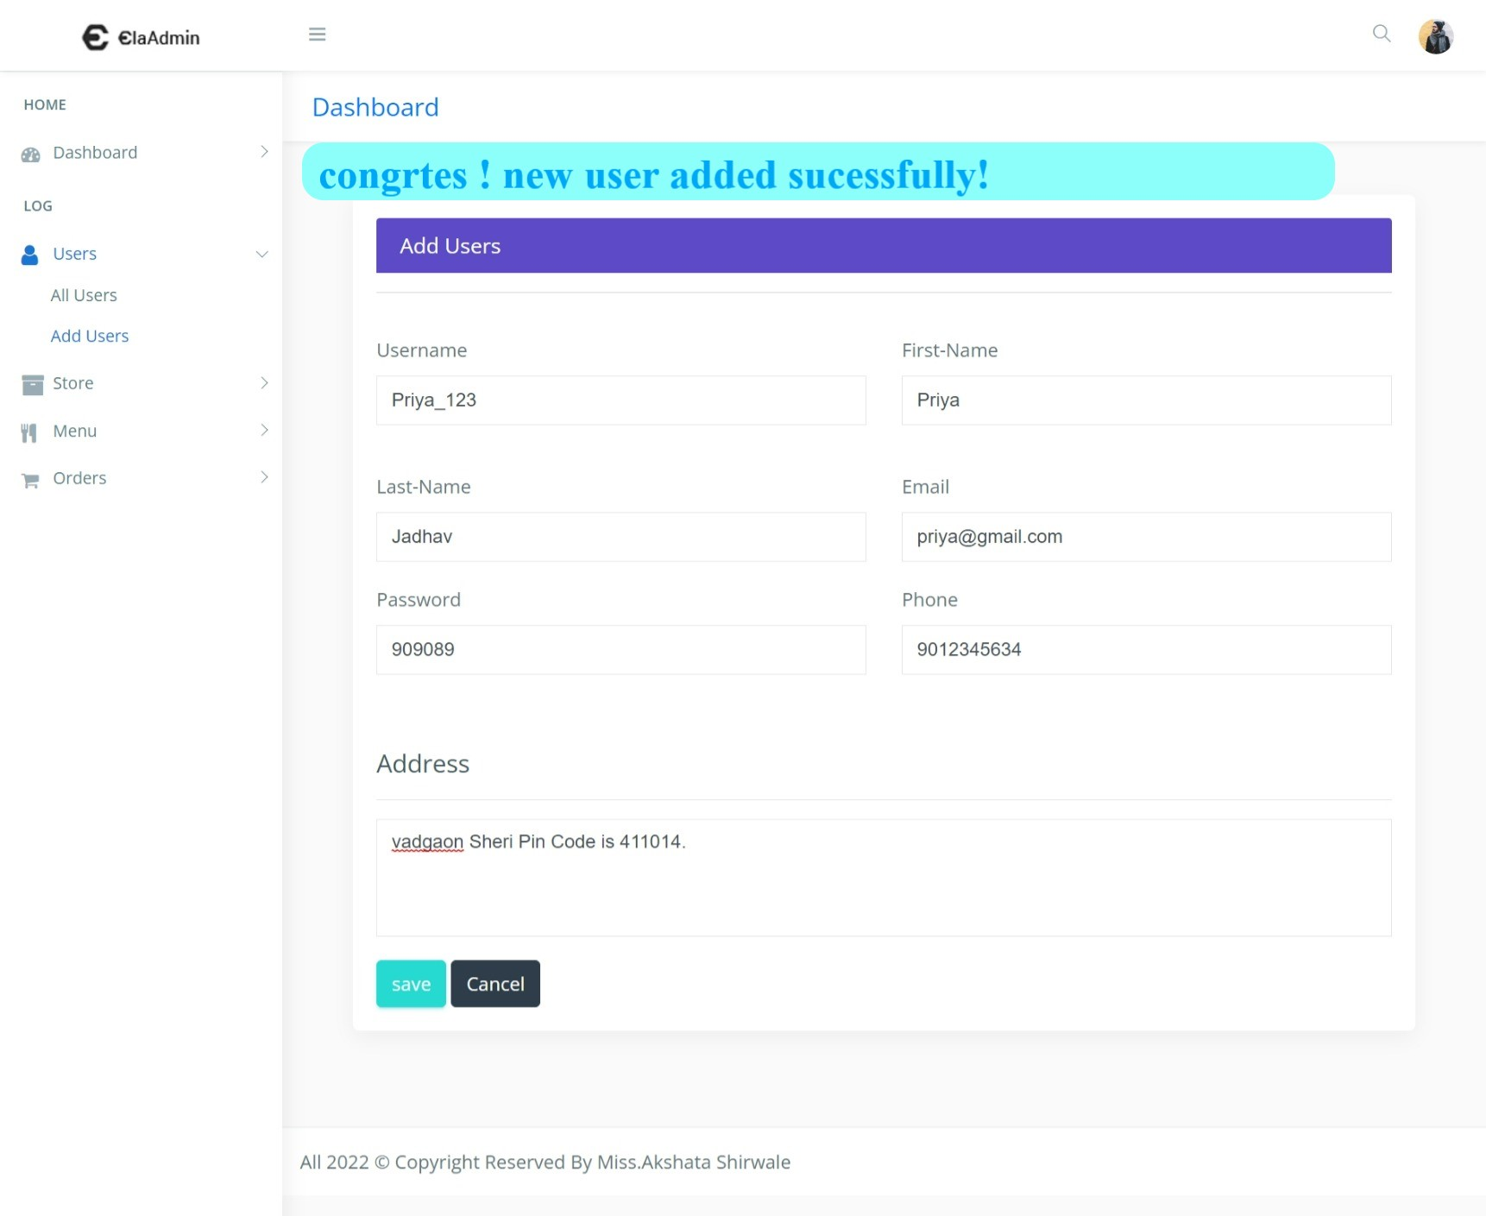
After successfully add the user :-

Slide 43
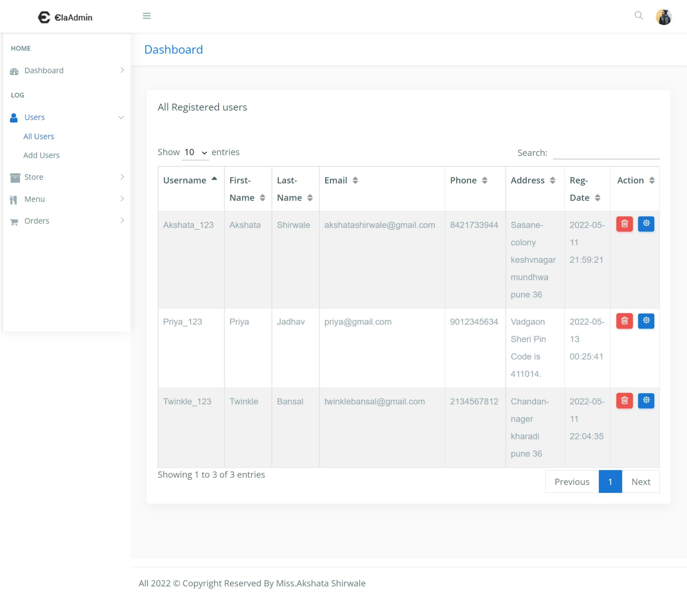
Display new user on dashboard :-

Slide 44
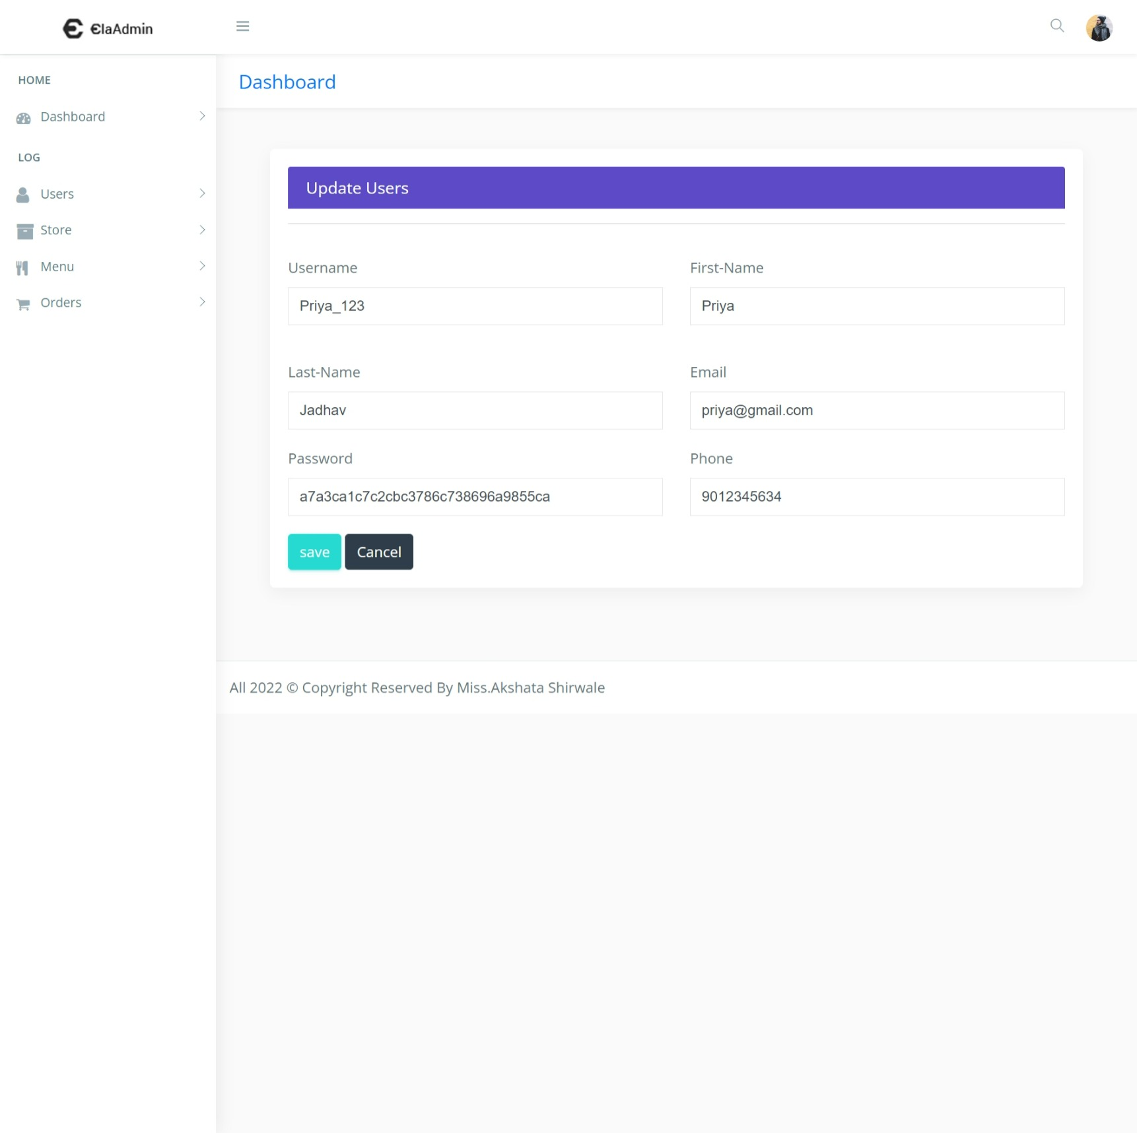
Update the user :-

Slide 45
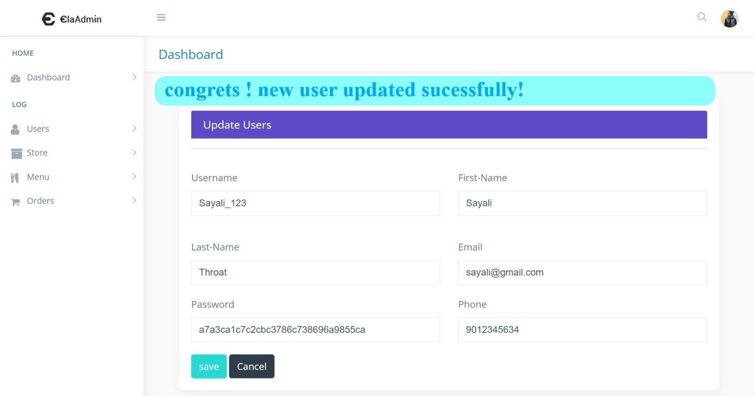
After successfully update the user:-

Slide 46
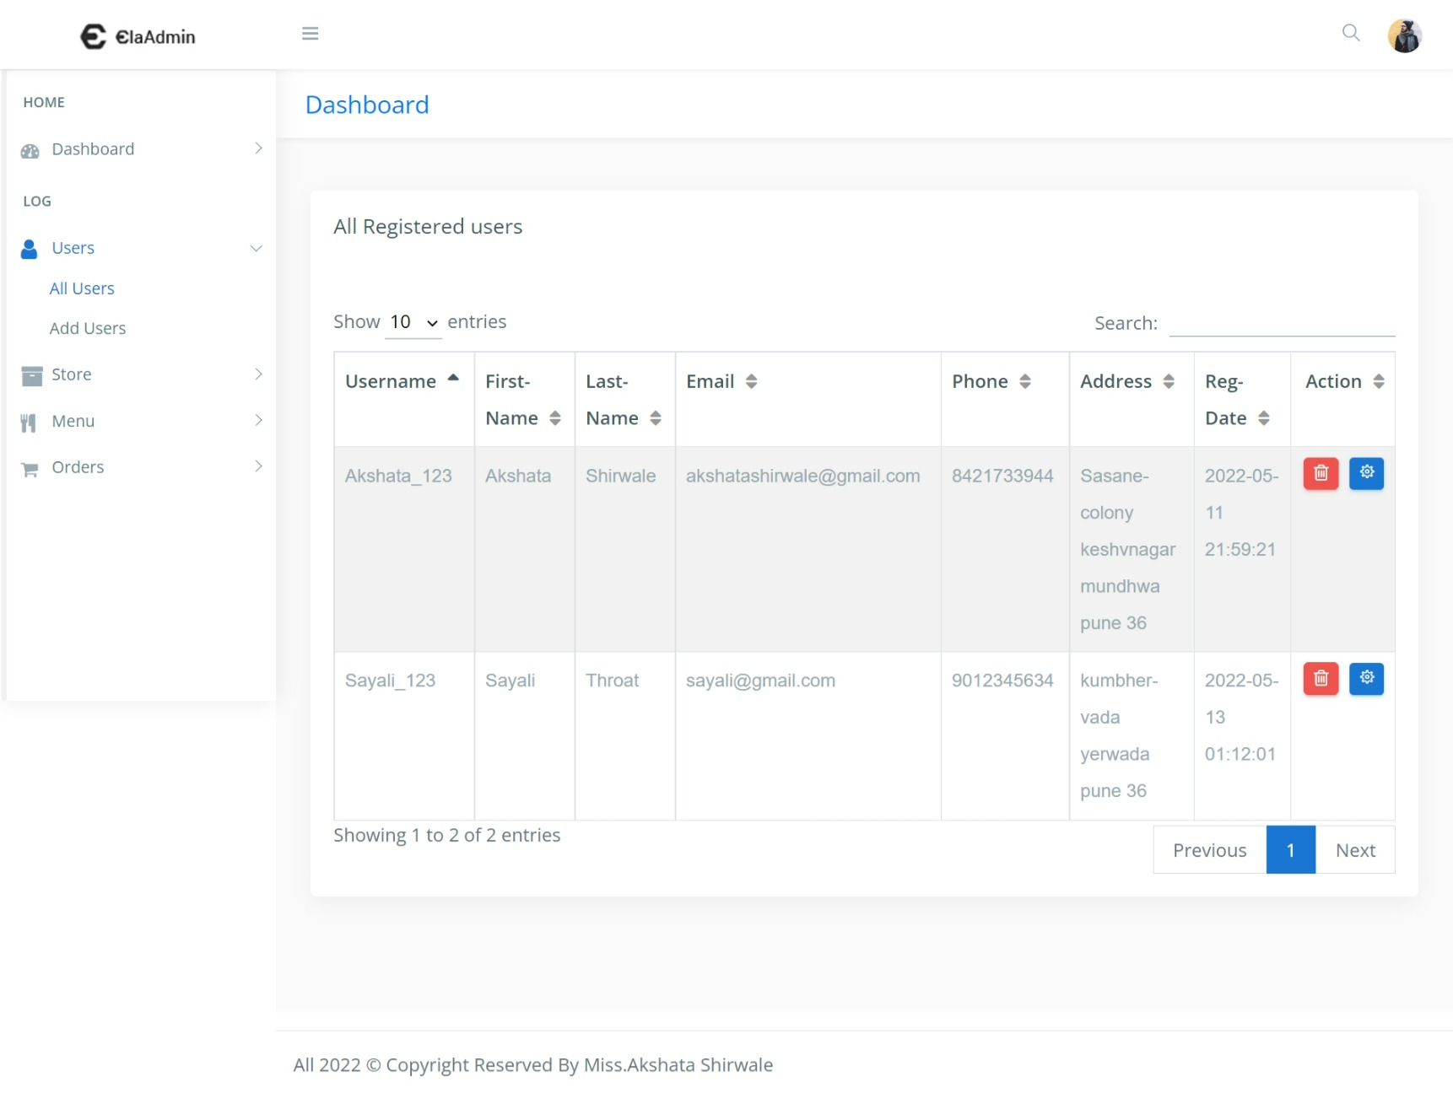
Display updated user on dashboard :-

Slide 47
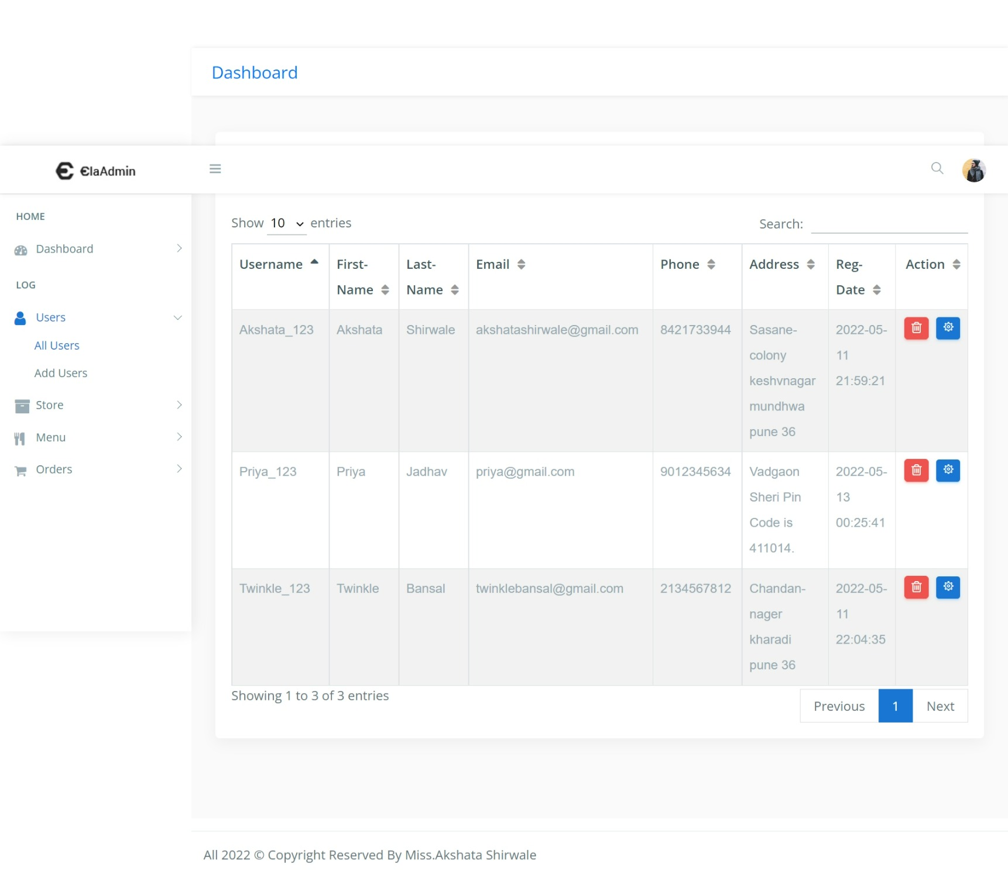
Delete the existing user :-

Slide 48
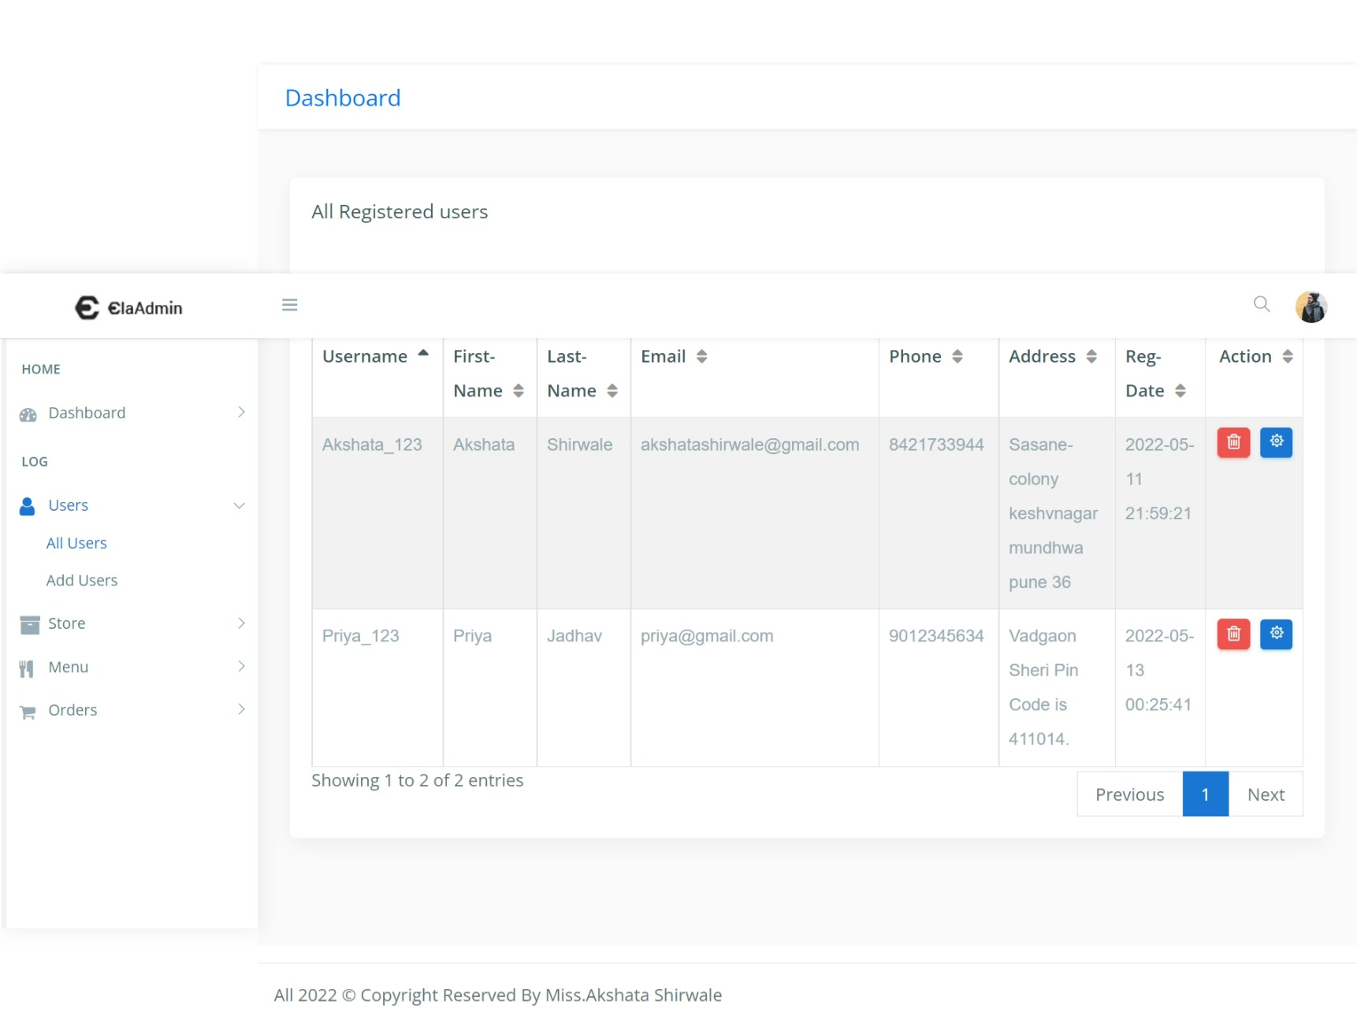
After successfully deleted user :-

Slide 49
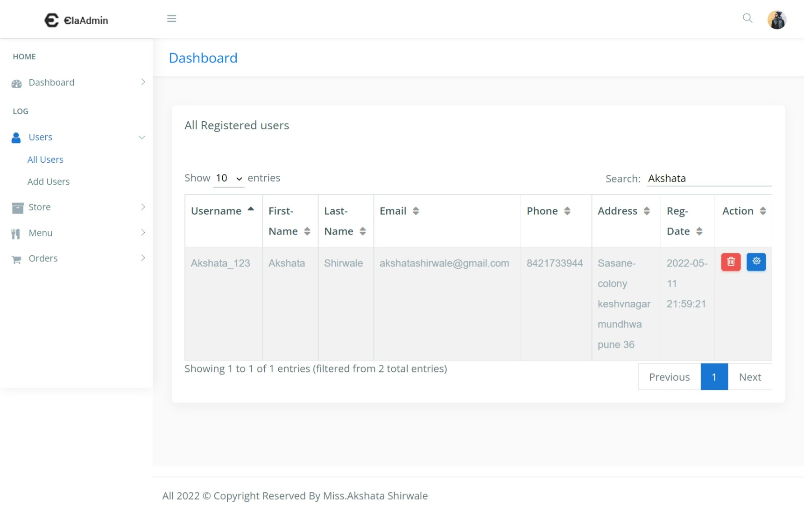
Search the user :-

Slide 50
All store dashboard :-

Slide 51
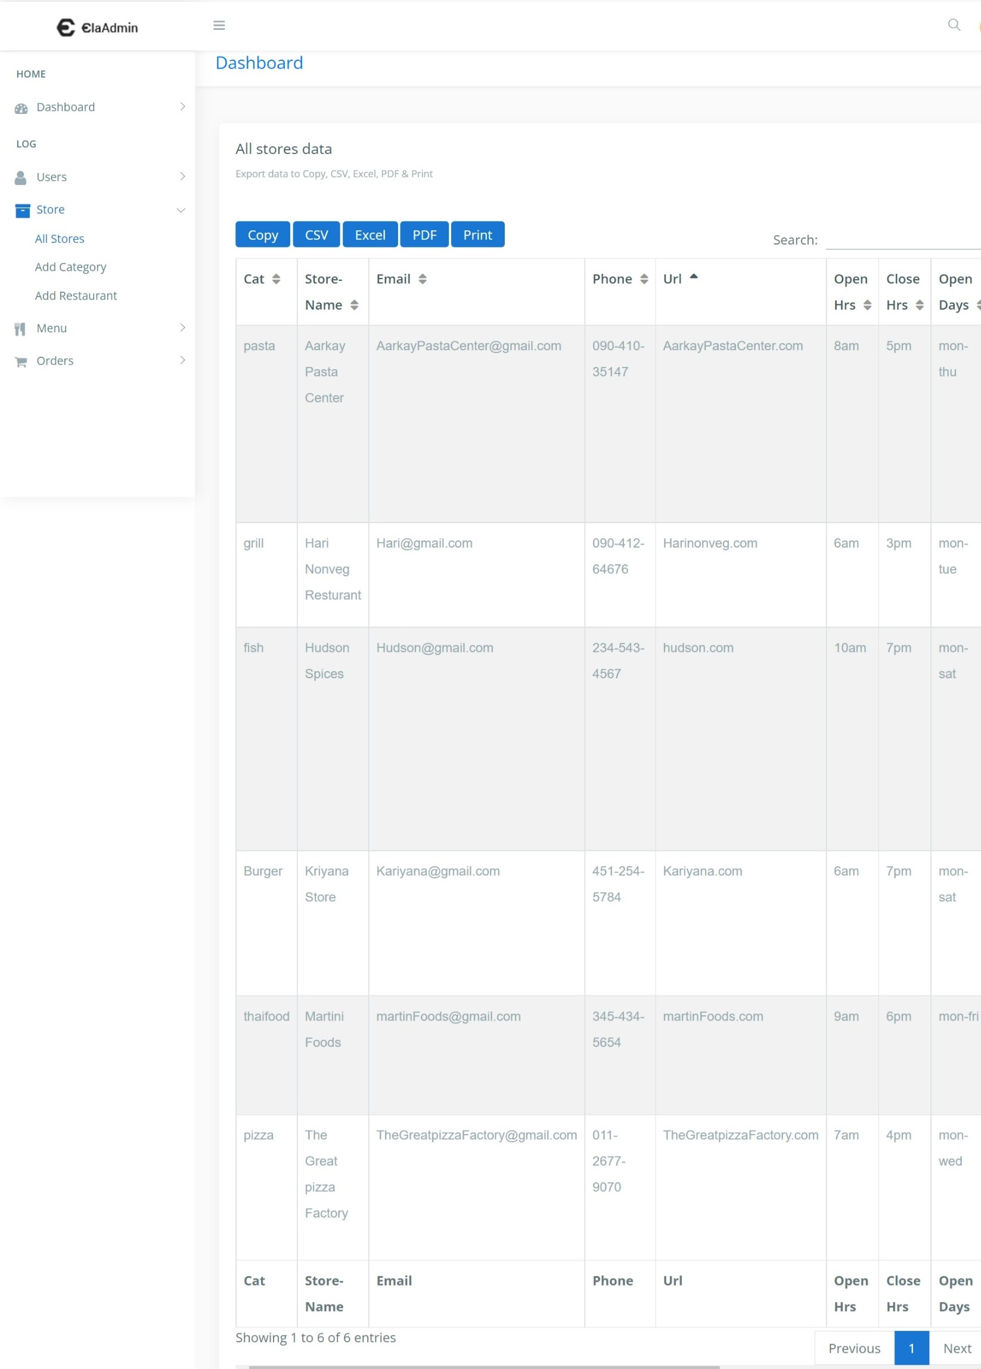
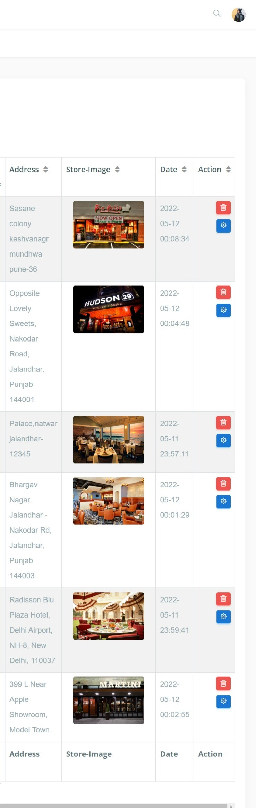

Slide 52
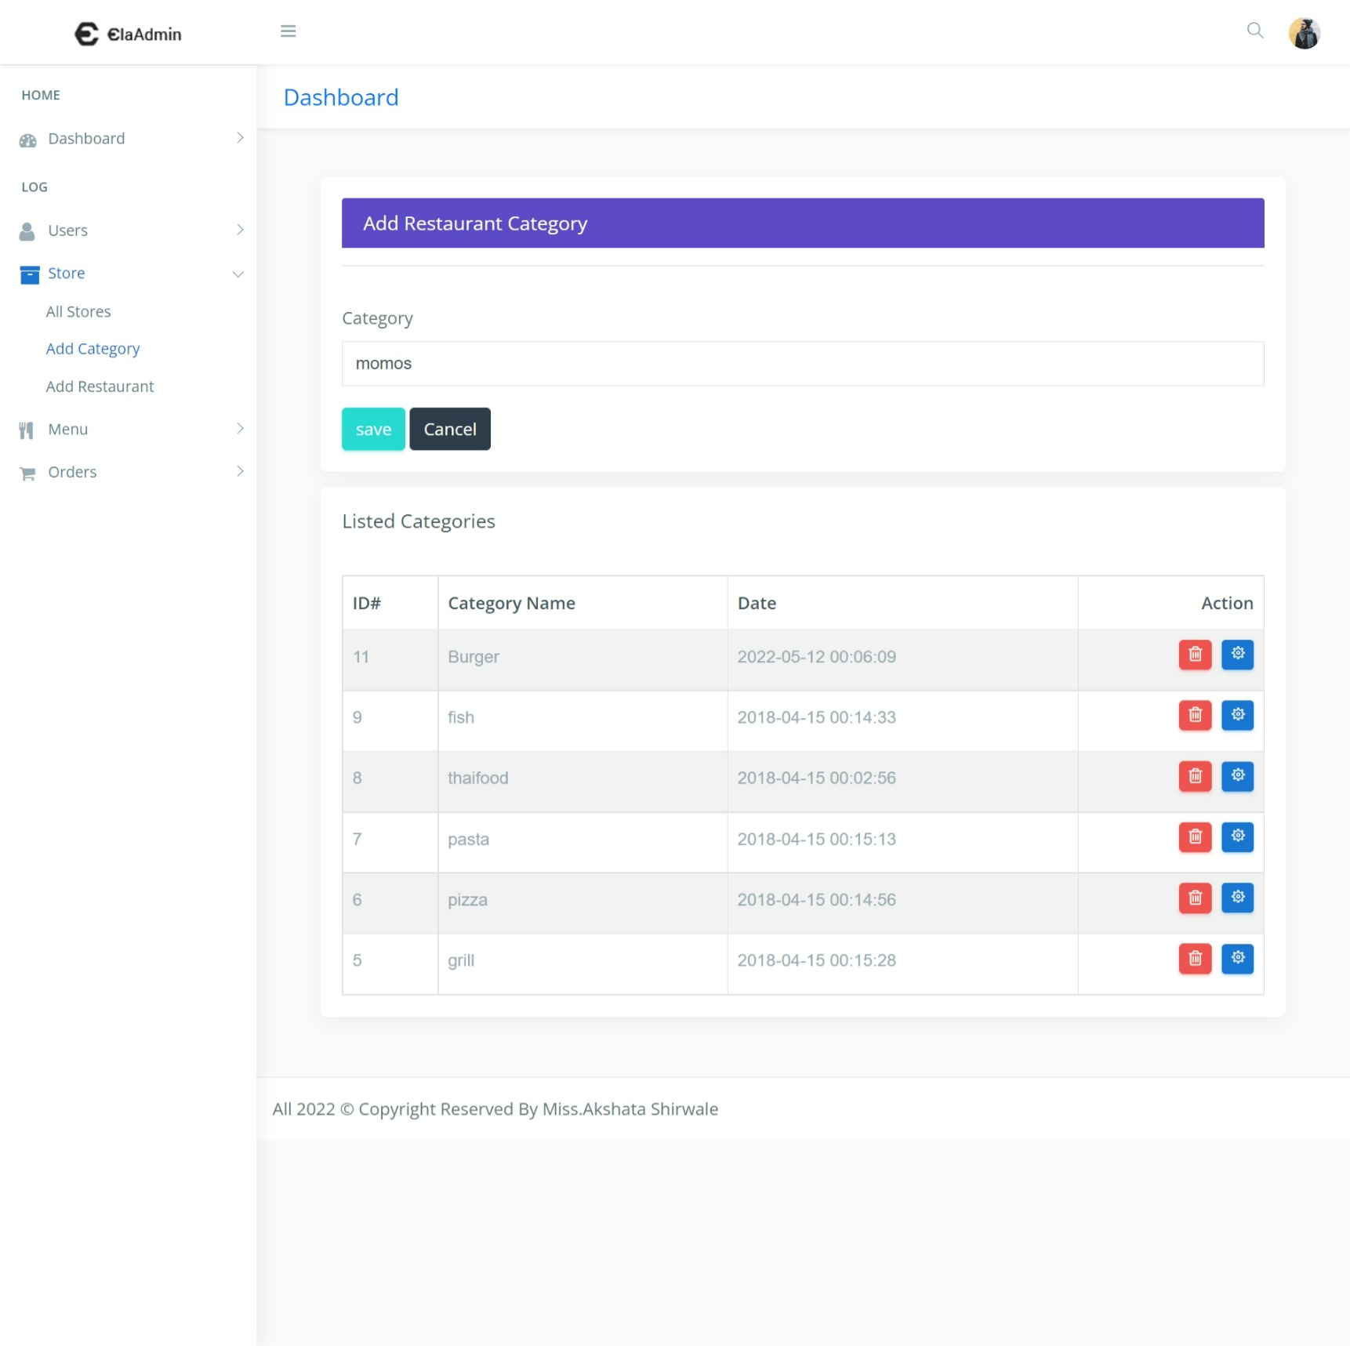
Add Restaurant Category :-

Slide 53
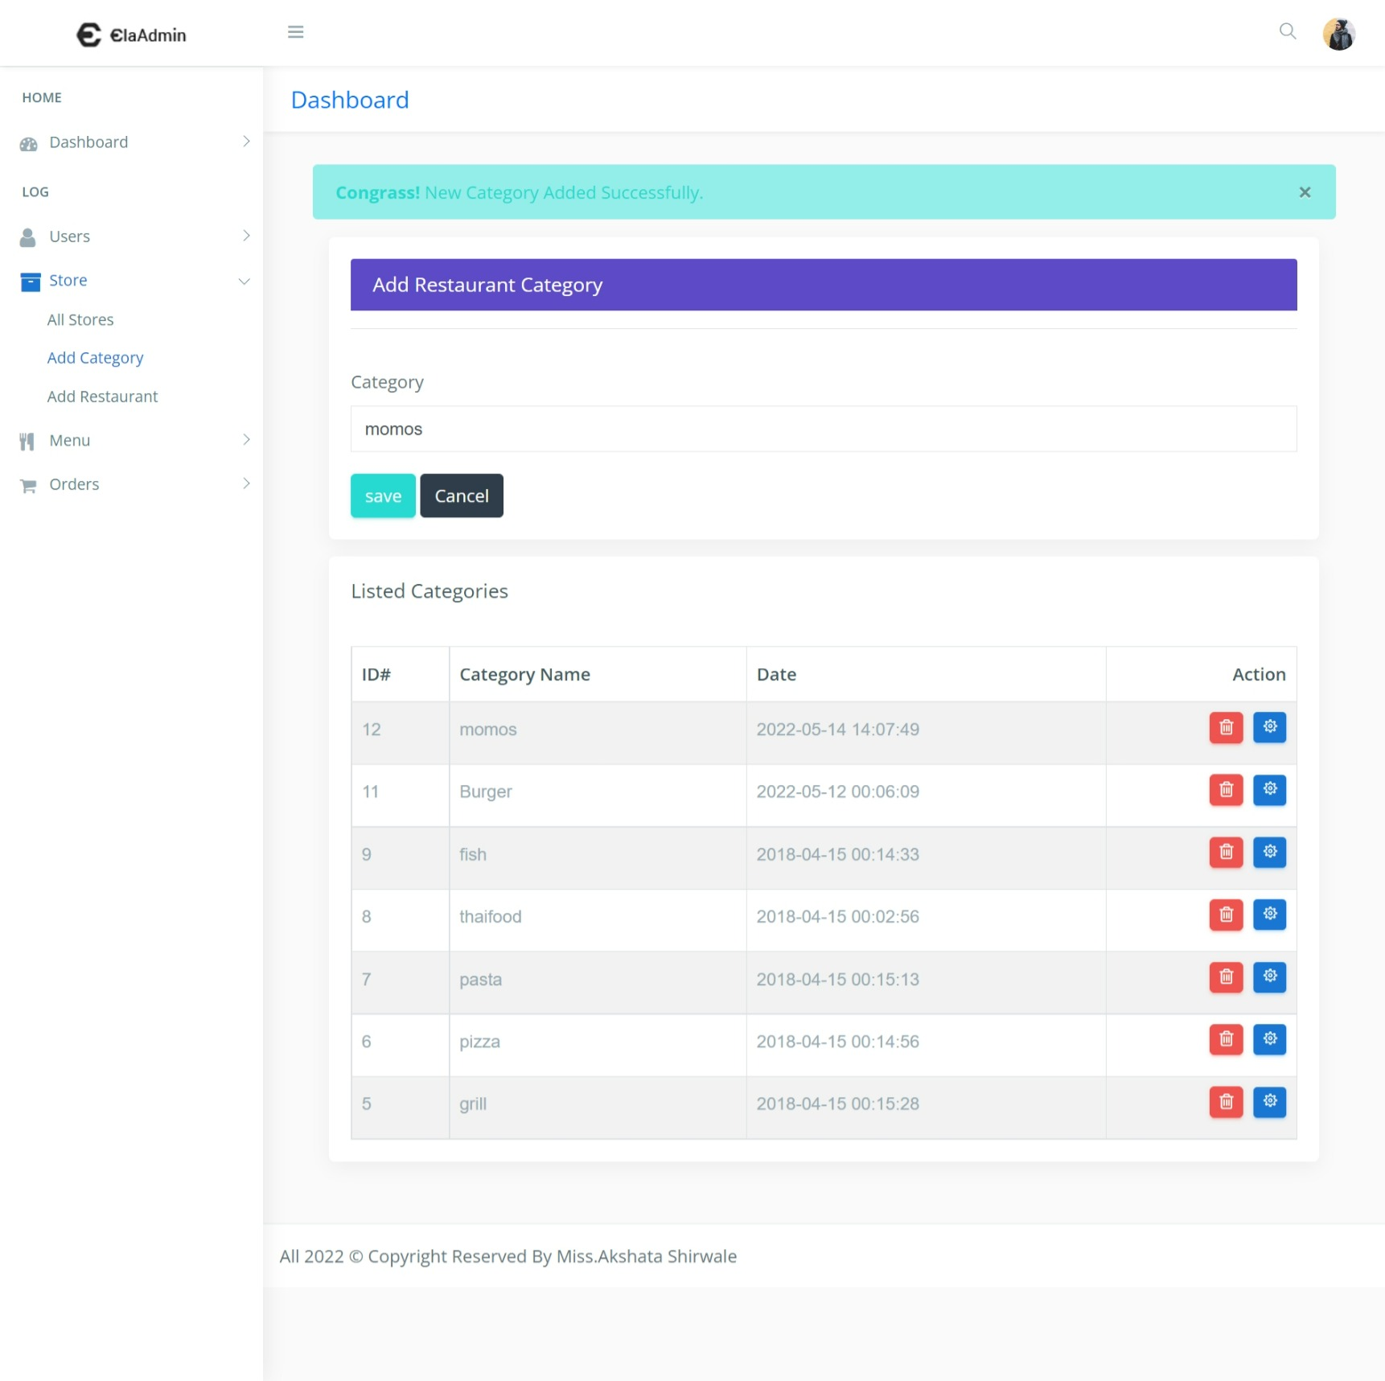
After successfully added the restaurant category :-

Slide 54
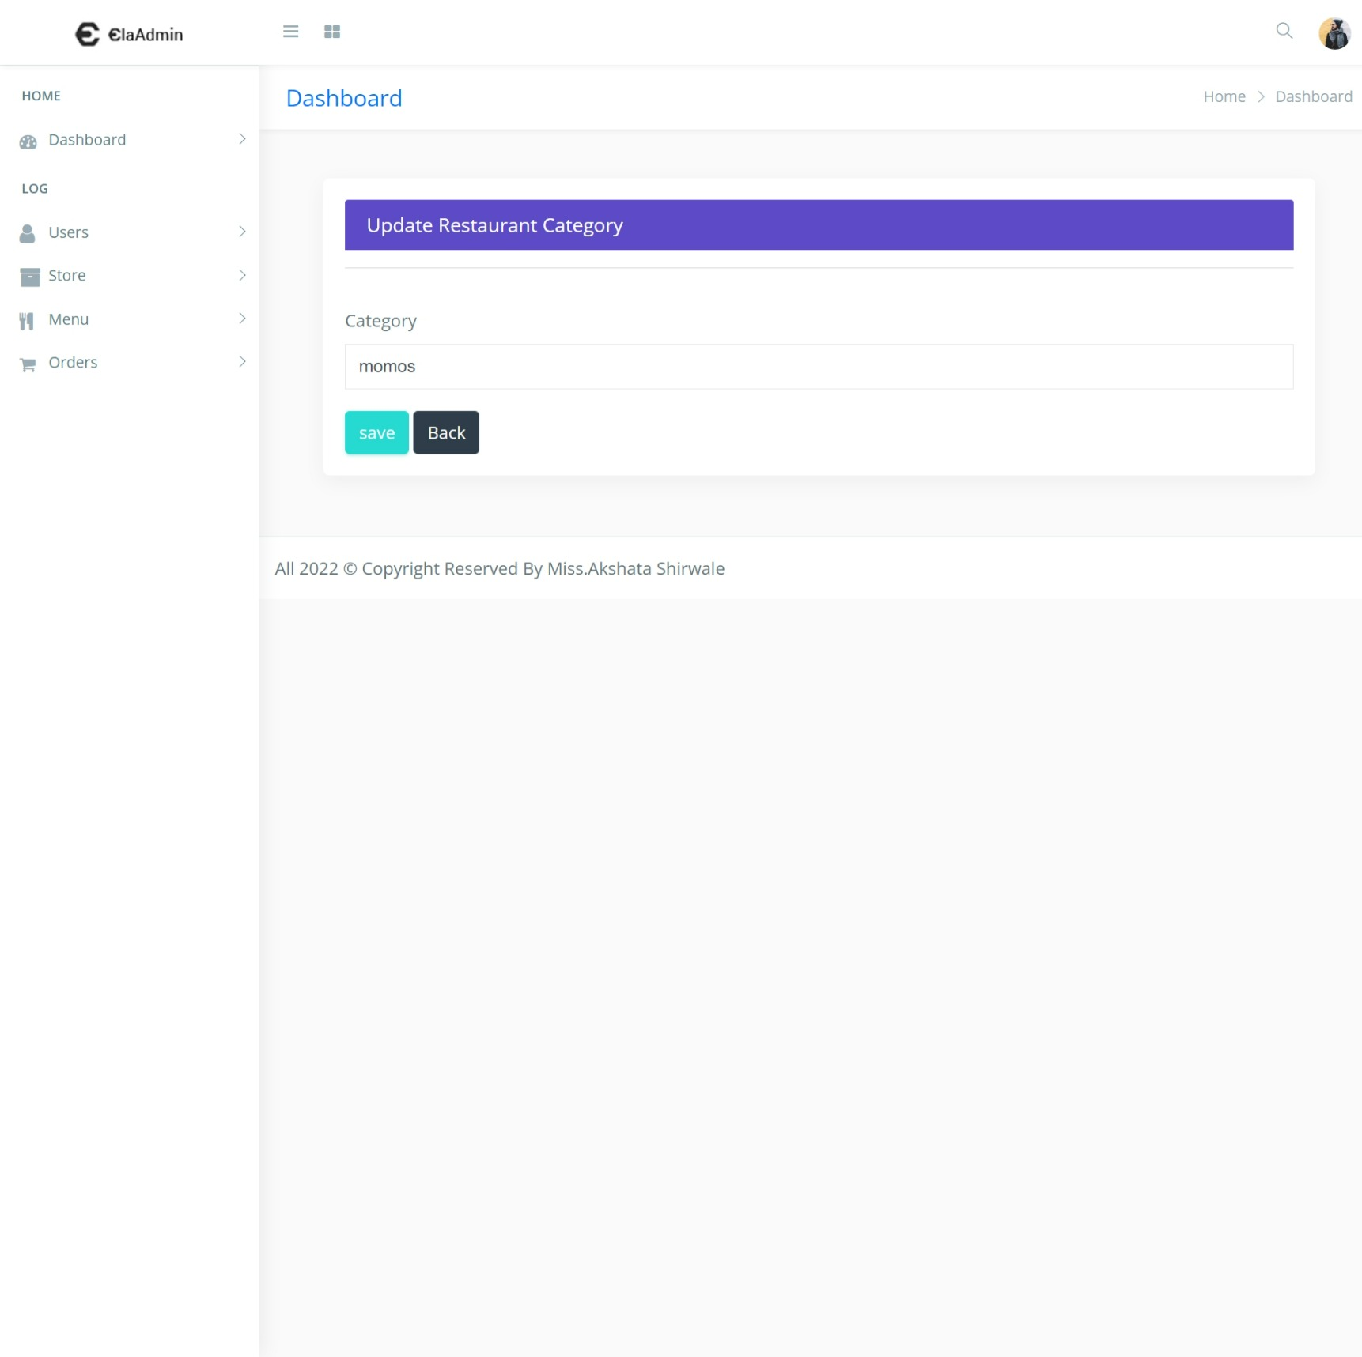
update Restaurant Category :-

Slide 55
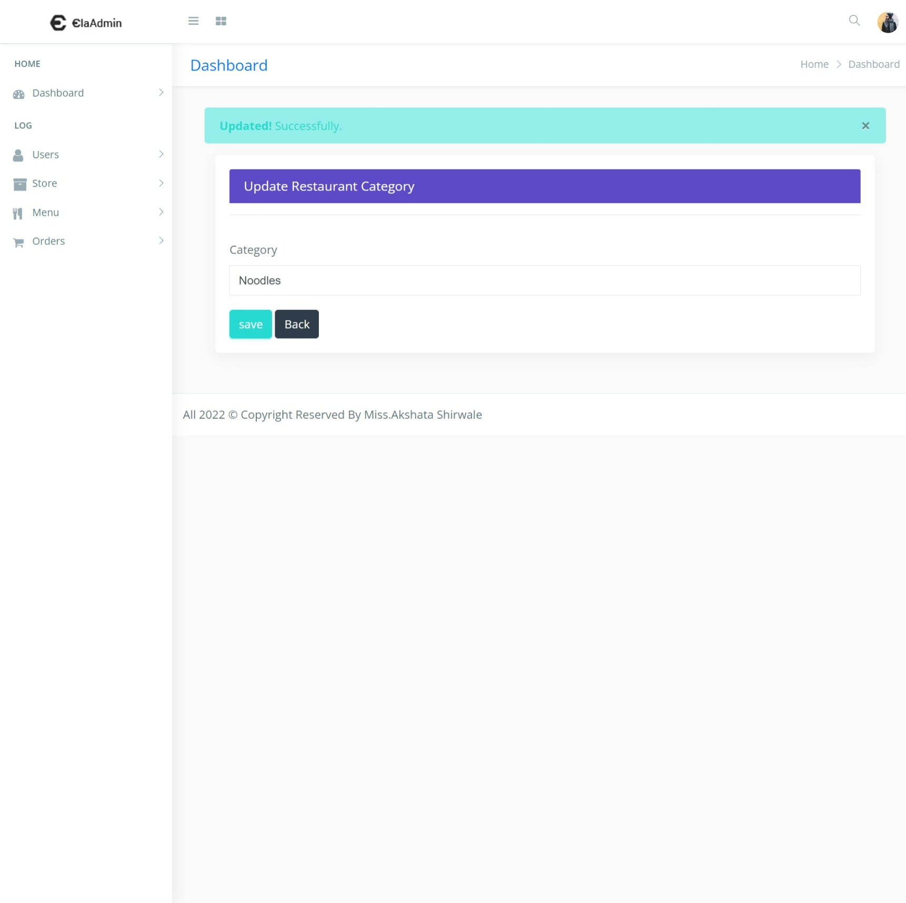
After successfully updated the restaurant category :-

Slide 56
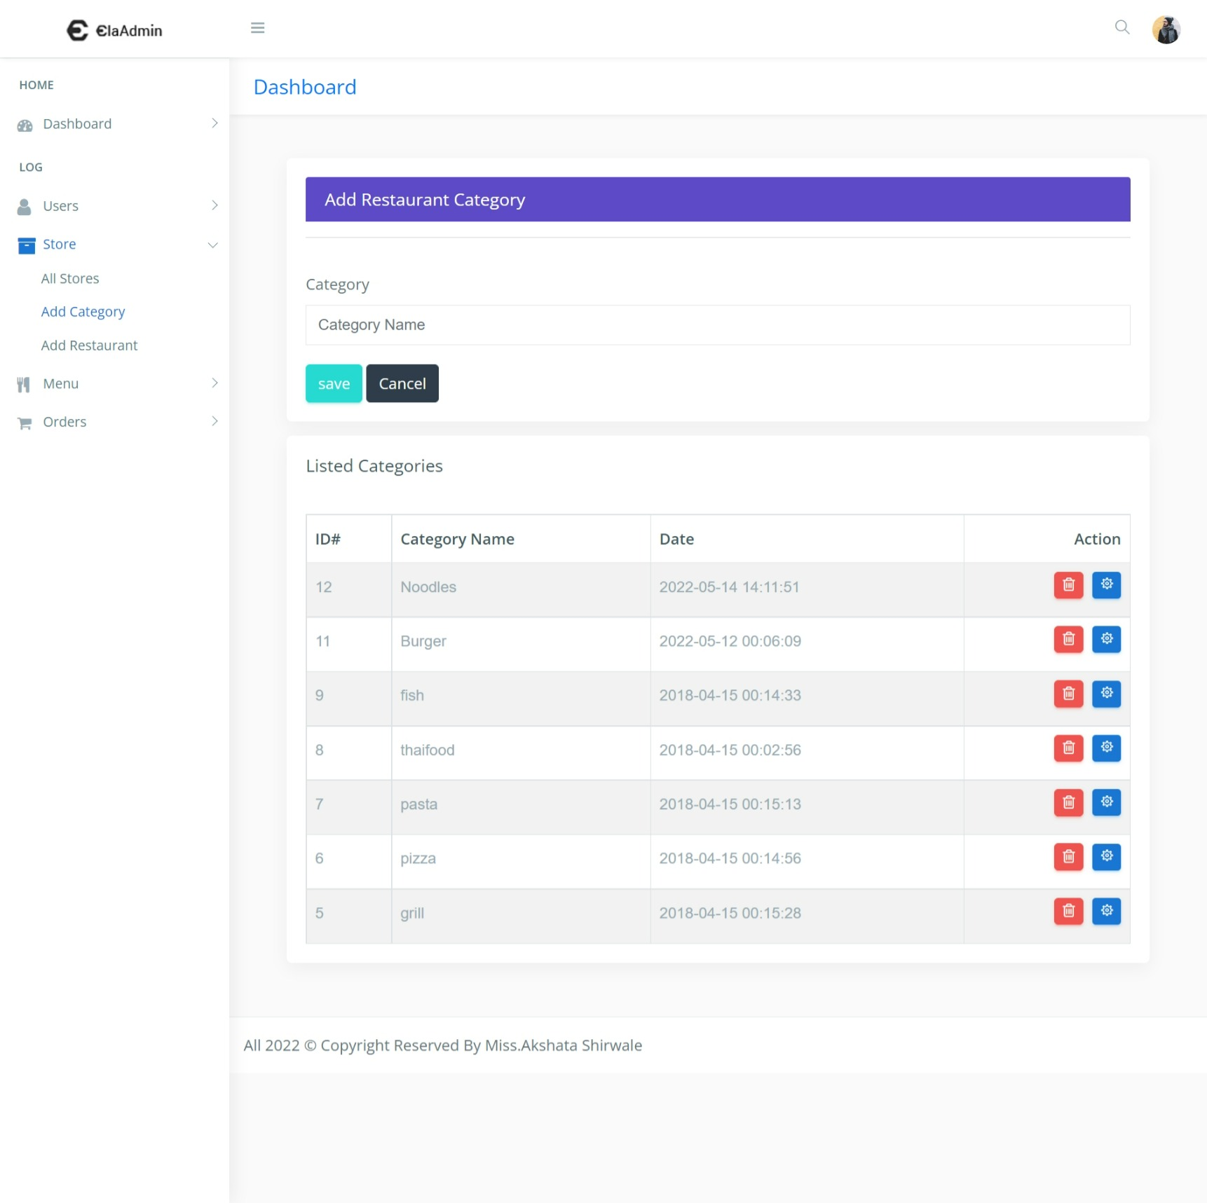
Display upated records on store dashboard :-

Slide 57
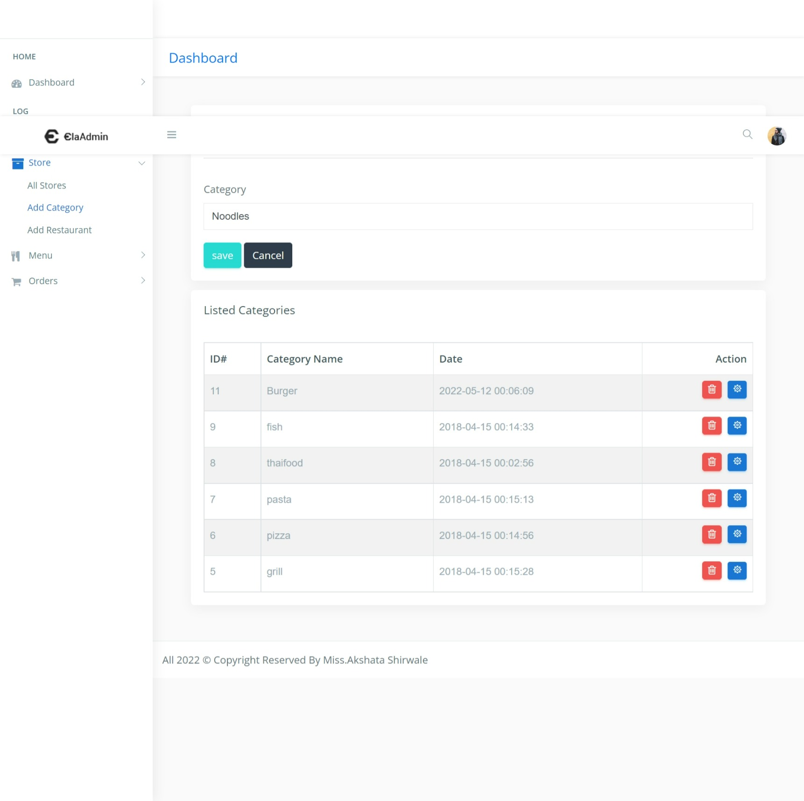
Delete the restaurant catgory:-

Slide 58
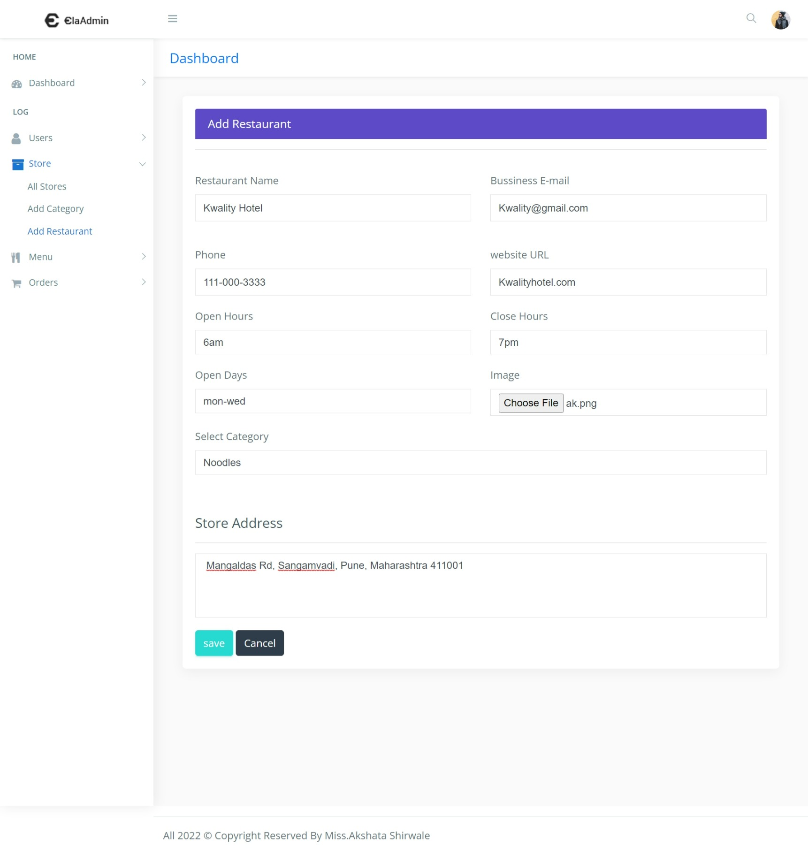
Add new restaurant :-

Slide 59
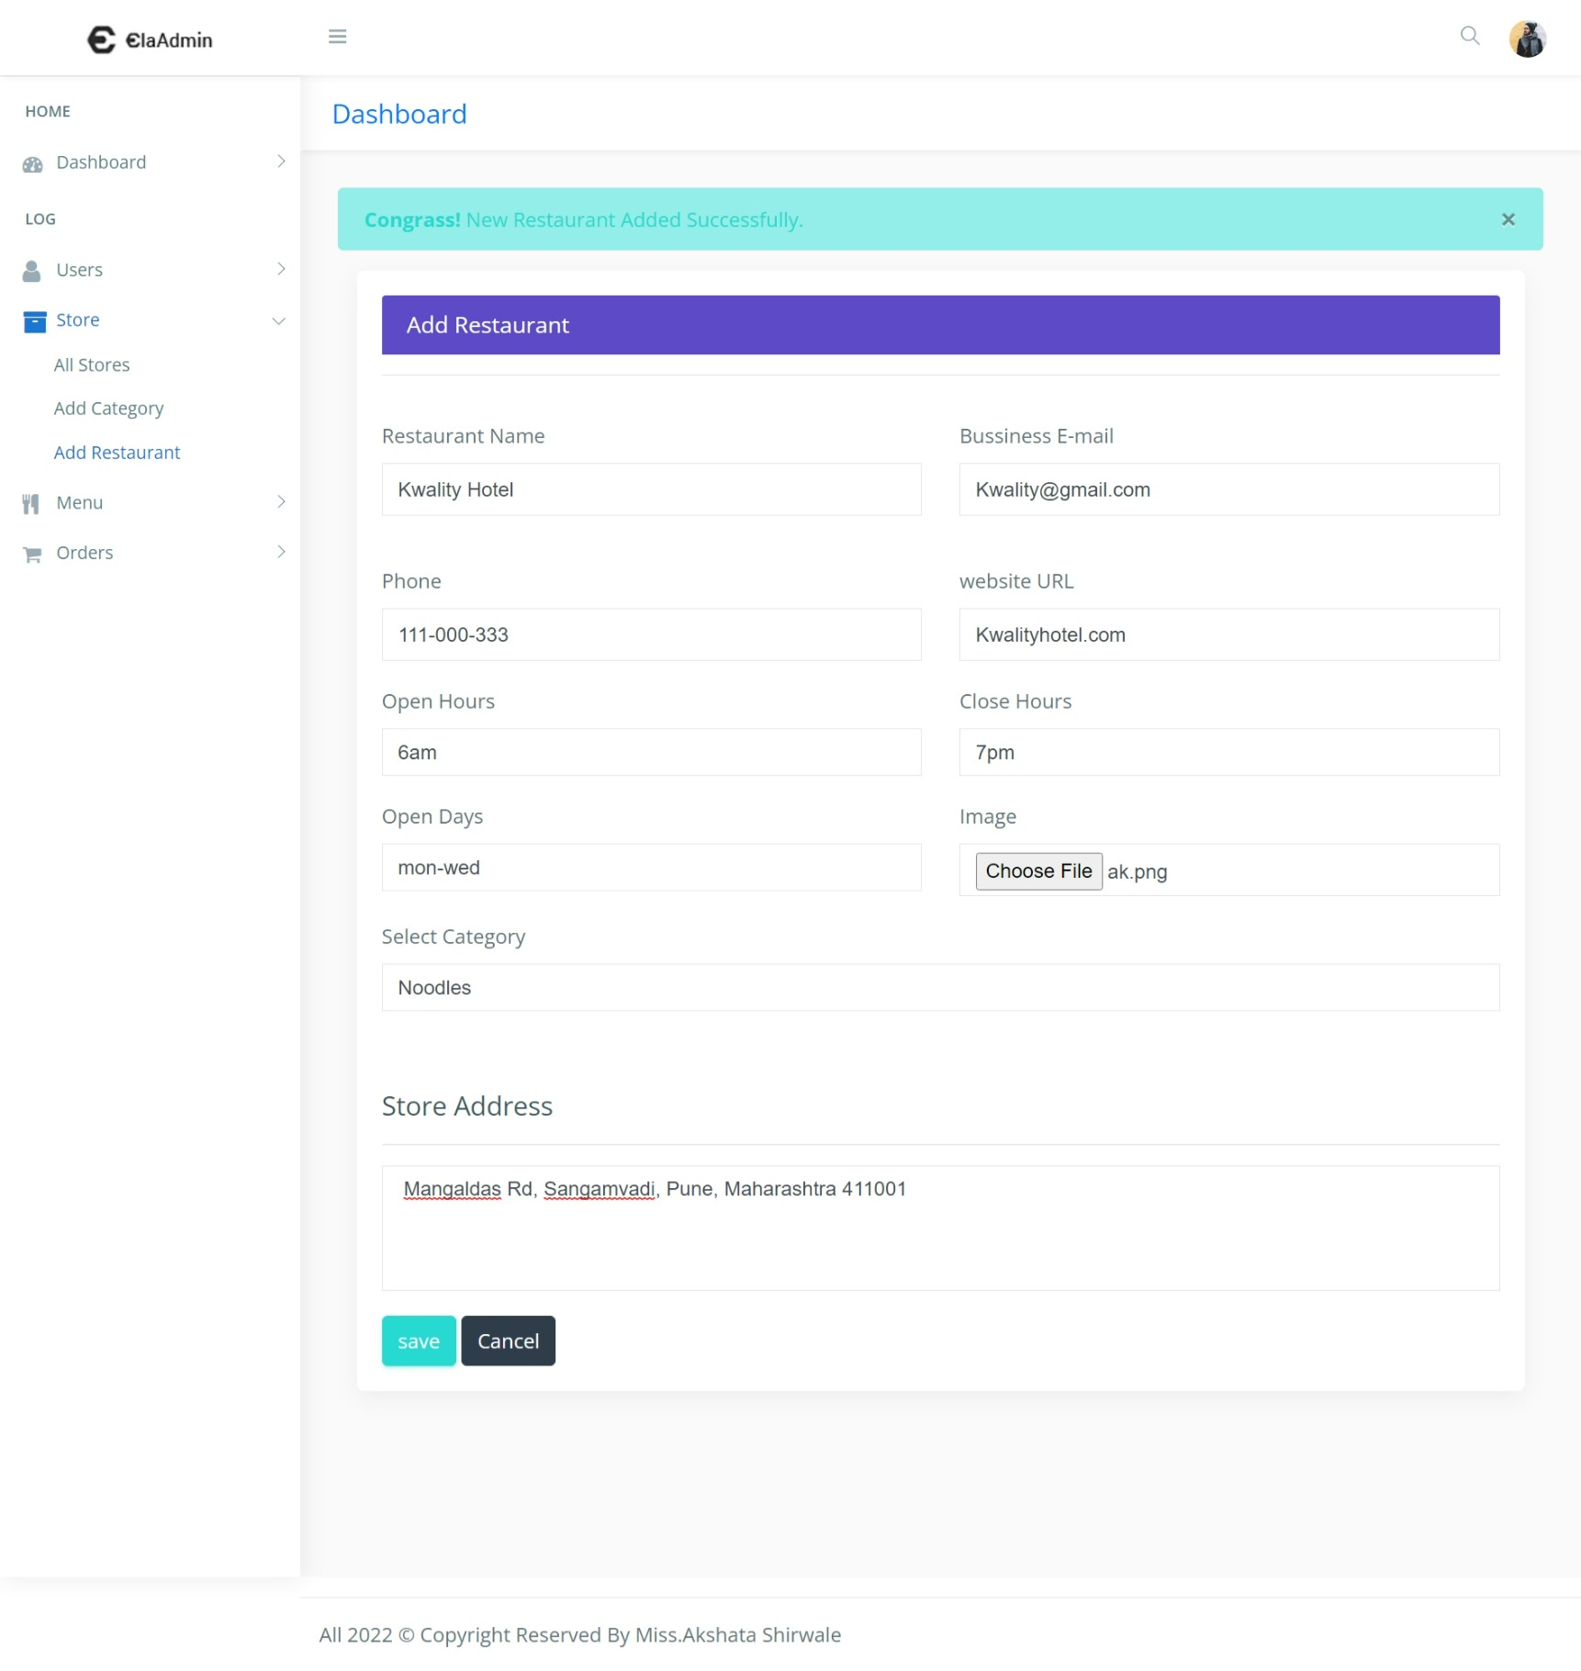
After successfully added the new restaurant :-

Slide 60
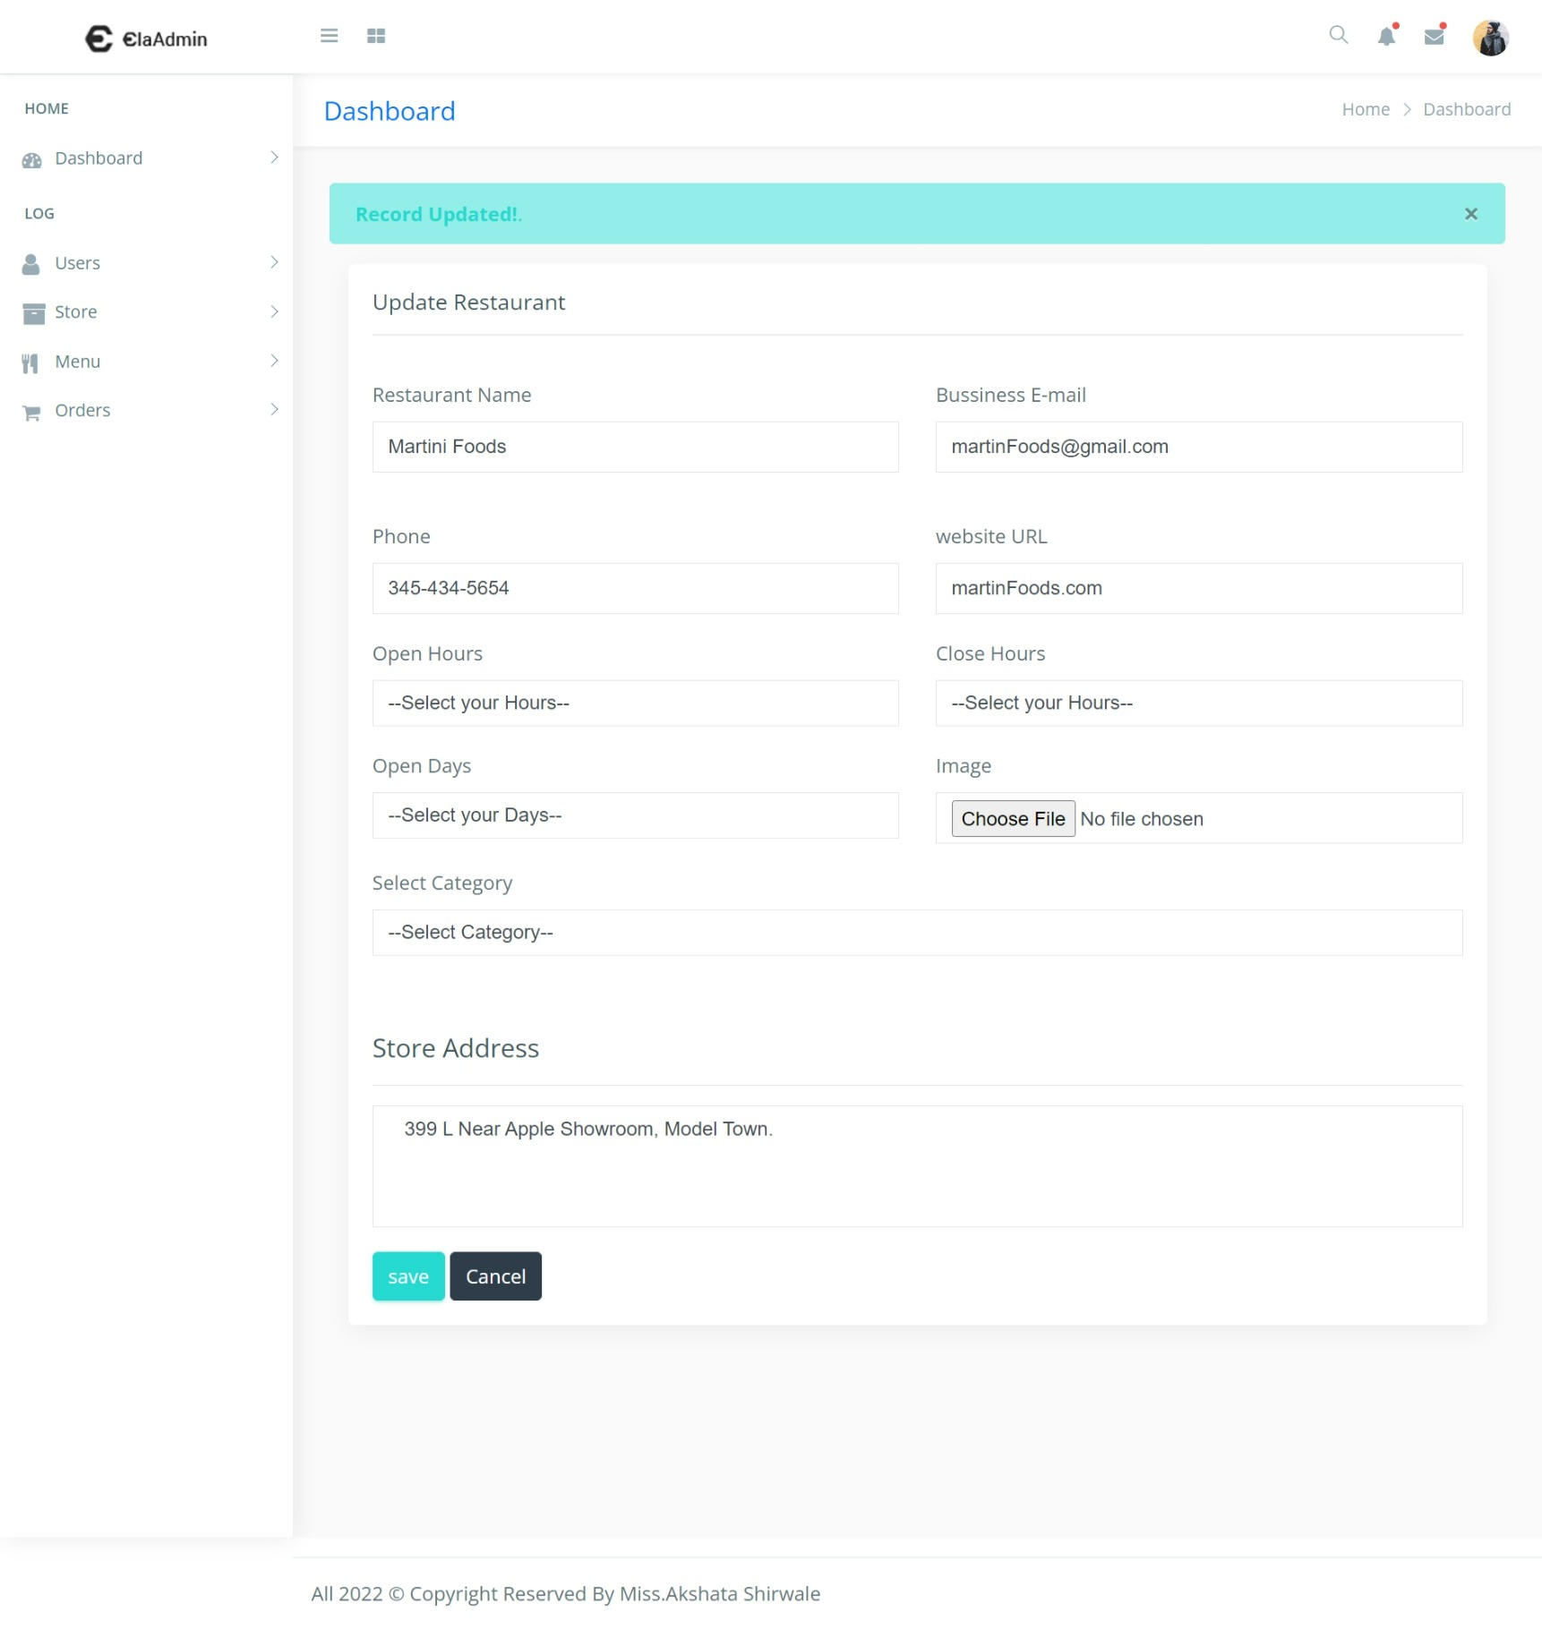
Update restaurant :-

Slide 61
Display upated records on all store dashboard :-

Slide 62
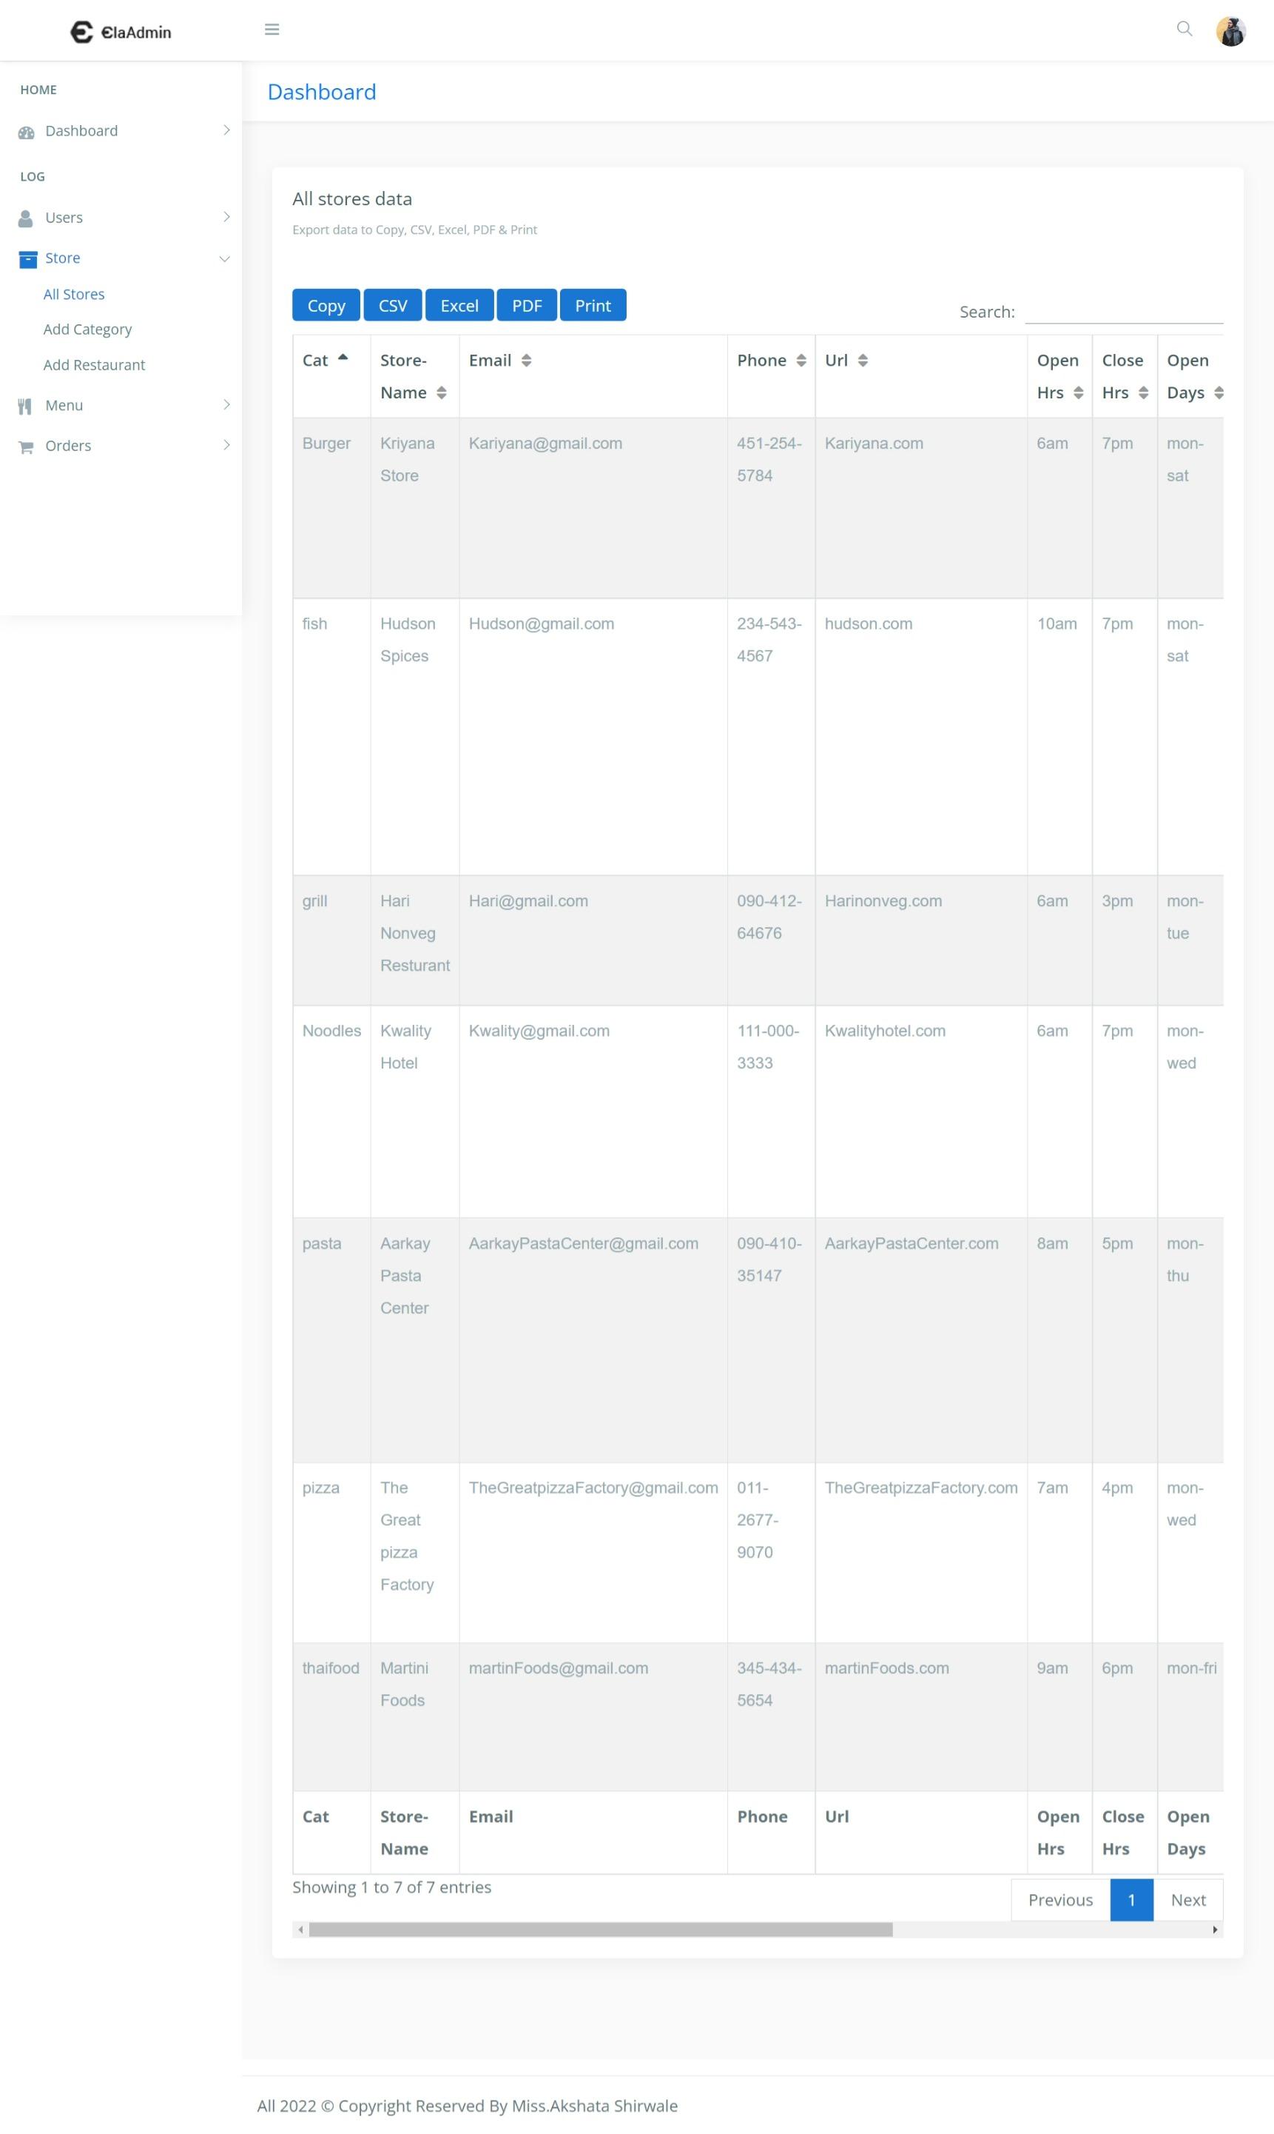
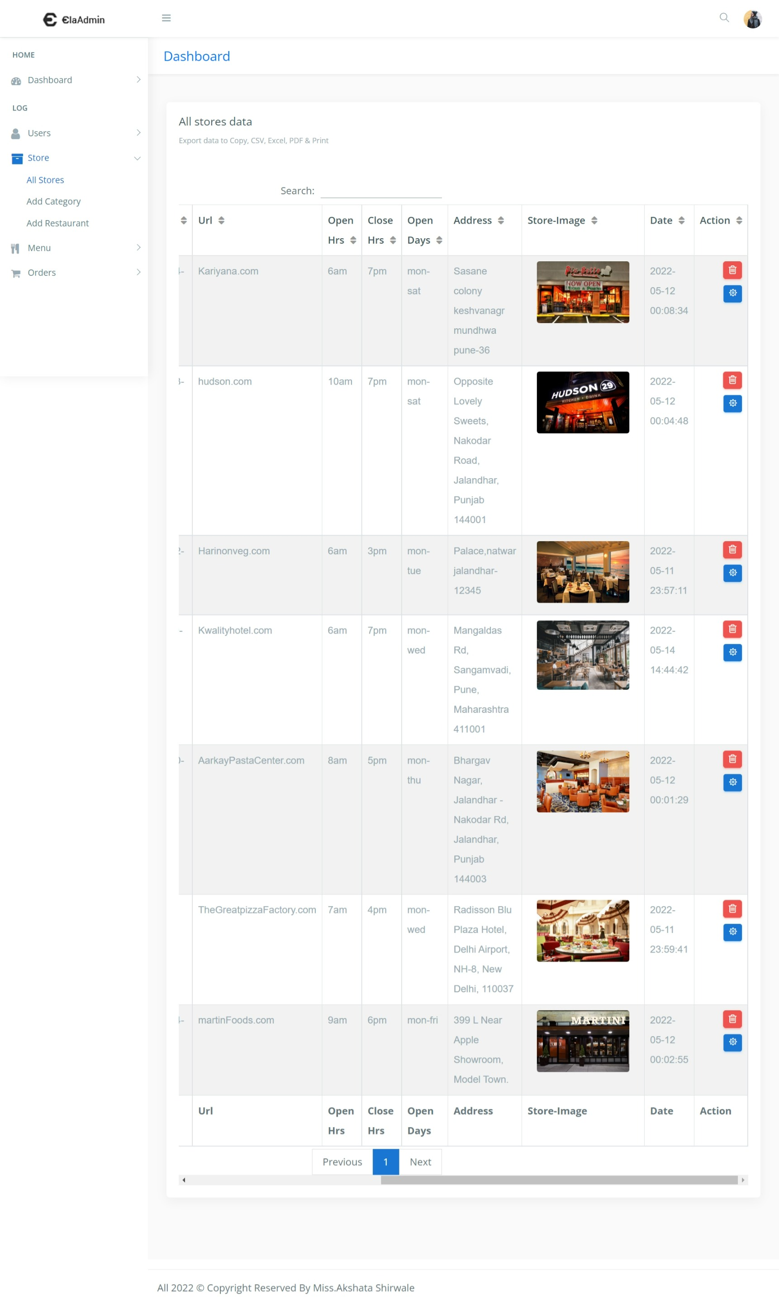

Slide 63
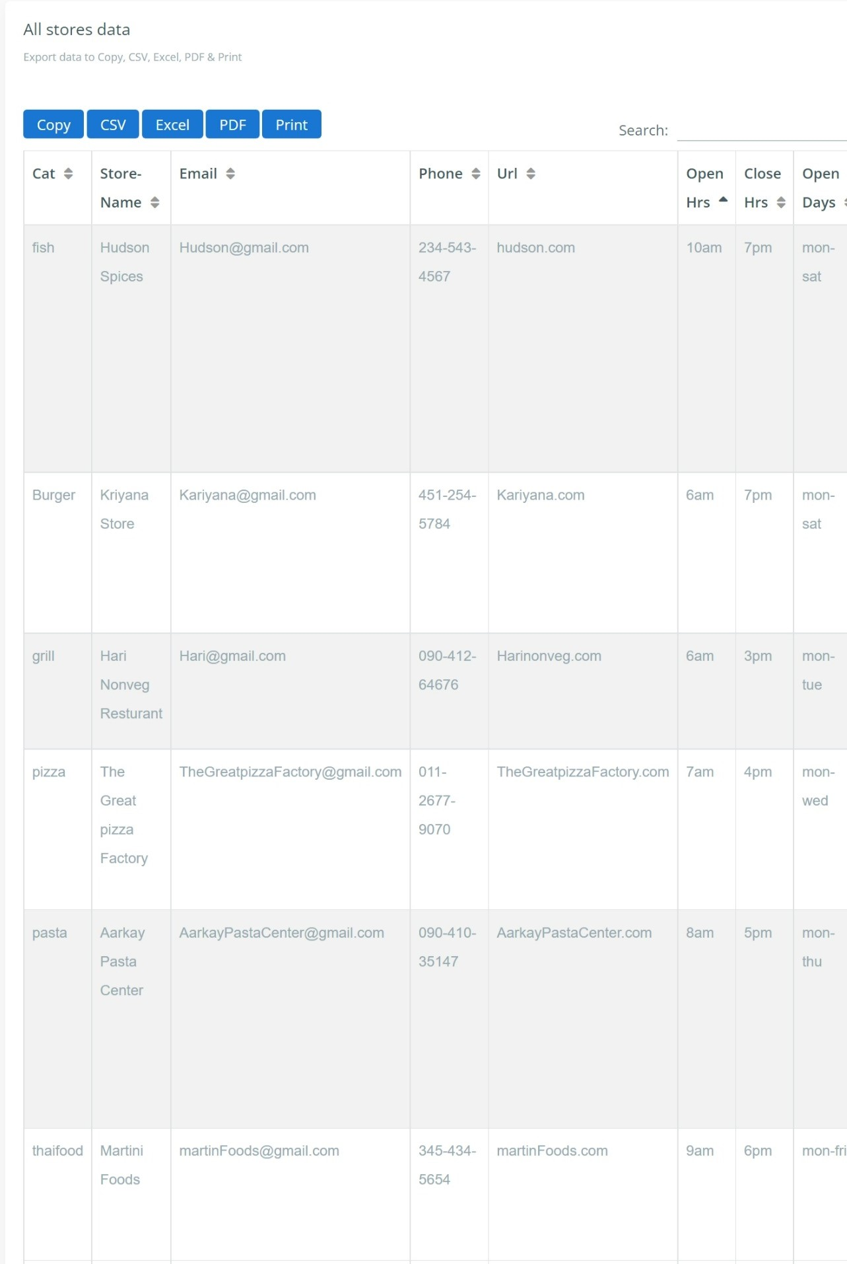
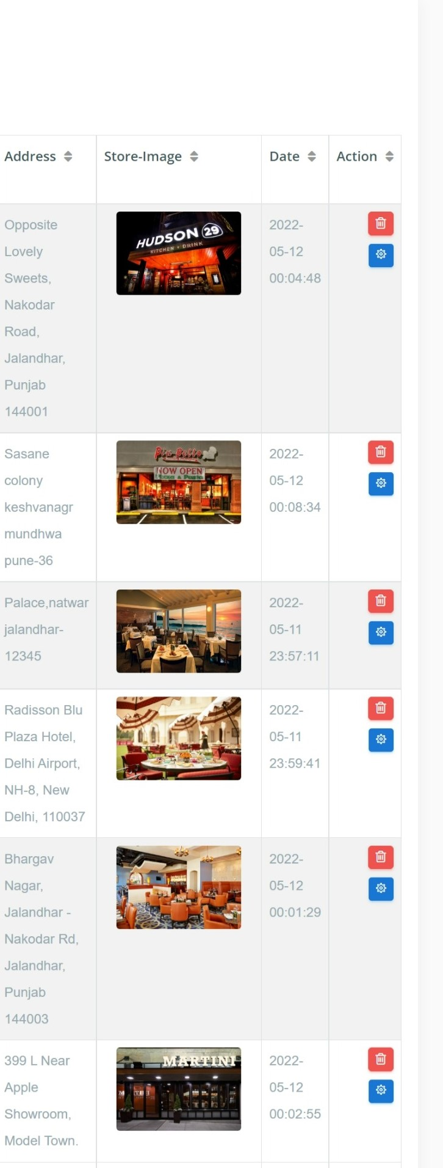
Delete restaurant :-

Slide 64


Search the restaurant :-

Slide 65
ALL MENU DASHBOARD :-

Slide 66


Slide 67

ADD MENU TO THE RESTAURANT :-

Slide 68

After successfully added the new MENU :-

Slide 69
UPDATE THE MENU :-

Slide 70

After successfully UPDATED the new MENU :-

Slide 71
DISPLAY ALL UPDATED AND ADDED RECOREDS ON THE DASHBOARD :-

Slide 72


Slide 73

DELETE THE MENU :-

Slide 74

SEARCH THE MENU :-

Slide 75

All order dashboard :-

Slide 76

View user details :-

Slide 77

Update the order :-

Slide 78

After successfully updated the form :-

Slide 79

Delete the order :-

Slide 80

After successfully deleted the order :-

Slide 81

Search the order :-

Slide 82

Reports to see all store information :-
CSV FORMAT :-

Slide 83

Excel format :-

Slide 84

Pdf format :-

Slide 85

Print format :-

Slide 86

Reports to see all menu information :-
CSV FORMAT :-

Slide 87

Excel format :-

Slide 88

Pdf format :-

Slide 89

Print format :-

Slide 90
LIMITATIONS :-
Although I have put my best efforts to make the software flexible, easy to operate but limitations cannot be ruled out even by me. Though the software presents a broad range of options to its users some intricate options could not be covered into it; partly because of logistic and partly due to lack of sophistication. Paucity of time was also major constraint, thus it was not possible to make the software fullproof and dynamic. Lack of time also compelled me to ignore some part such as storing old result of the candidate etc. Considerable efforts have made the software easy to operate even for the people not related to the field of computers but it is acknowledged that a layman may find it a bit problematic at the first instance. The user is provided help at each step for his convenience in working with the software.
List of limitations :-
This application will only run in Windows Operating System.
This application does not provide automatic recovery and backup feature.
The transactions are executed in off-line mode, hence the invoice payment receipt are not generated right now.
The order is cancelled the cancel receipt of the food is not generated right now.

Slide 91
Conclusions :-
Our project is only a humble venture to satisfy the needs to manage their project work. Several user friendly coding have also adopted. This package shall prove to be a powerful package in satisfying all the requirements of the school. The objective of software planning is to provide a frame work that enables the manger to make reasonable estimates made within a limited time frame at the beginning of the software project and should be updated regularly as the project progresses.
• Paper Work is removed as far as possible.
• The information of customer’s customer’s orders, cancellation, payment and refund (if any)
are collected, stored and updated efficiently.
• Reports of information of customer’s order, payment their menu, are generated quickly.
• Daily income information of customer’s is ascertained.
• Monthly income information of booked orders of customers is ascertained.
• Daily orders and events order’s and information is maintained efficiently.

Slide 92
BIBLIOGRAPHY
References and Bibliography :-
• Google for problem solving
• http://www.javaworld.com/javaworld/jw-01- 1998/jw- 01-Credentialreview.html
• Database Programming with JDBC and Java by O'Reilly
• Head First Java 2nd Edition
• http://www.jdbc-tutorial.co99
• Java and Software Design Concepts by Apress
• https://www.tutorialspoint.com/java/
• http://www.javatpoint.com/java-tutorial
• https://docs.oracle.com/javase/tutorial/
• http://www.wampserver.com/en/
• http://www.JSP.net/
• http://www.tutorialspoint.com/mysql/
• httpd.apache.org/docs/2.0/misc/tutorials.html

